Slide 1
Booking Differently
kinkobooking.com
Notes:
Hi my name is Bilel and I am the cofounder and CEO of Kinko – I am here to present how we see booking differently for the hospitality sector.

Slide 2
Specific Stock
For each distribution channel
Churn Risk
Increases for Hotels & Partners
Notes:
Booking a room is a confusing task because travel agencies and hotel websites display different room availability and prices.
In fact Hotels allot specific stock for their partners which does not reflect the real situation
This increases the churn risk as customers will try to find another alternative
Either by using a different booking platform or by looking for another place to stay

Slide 3
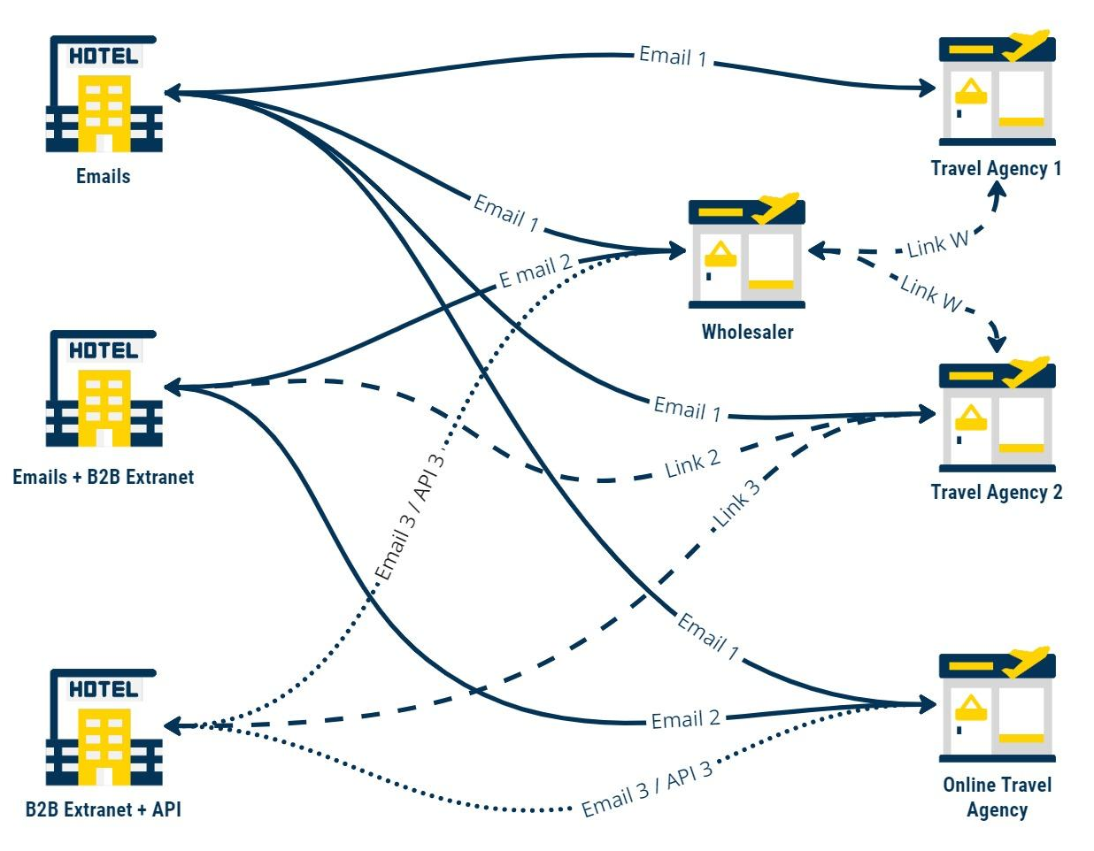
The Archaic Way of Booking a room
No Access
to Real Time Availability
Fixed Rates
& On-demand Stock
Fake Sold Out
& Overbooking
Notes:
Actually, communication is done in an archaic way between hotels and their partners.
It depends on different channels and tools - It is fragmented, messy and outdated,
This results in
Travel agencies not having access to real time room availability.
and Hotels have to rely on contracts with fixed rates and on-demand stock
This brings nothing but Fake Sold Out and overbooking

Slide 4
B2B Booking Marketplace
between Hotels / Guest Houses and their Partners
Local Travel Agencies - Wholesalers - Online Travel Agencies
Notes:
That’s why we built Kinko - a B2B booking marketplace between Hotels / Guest houses and their partners

Slide 5
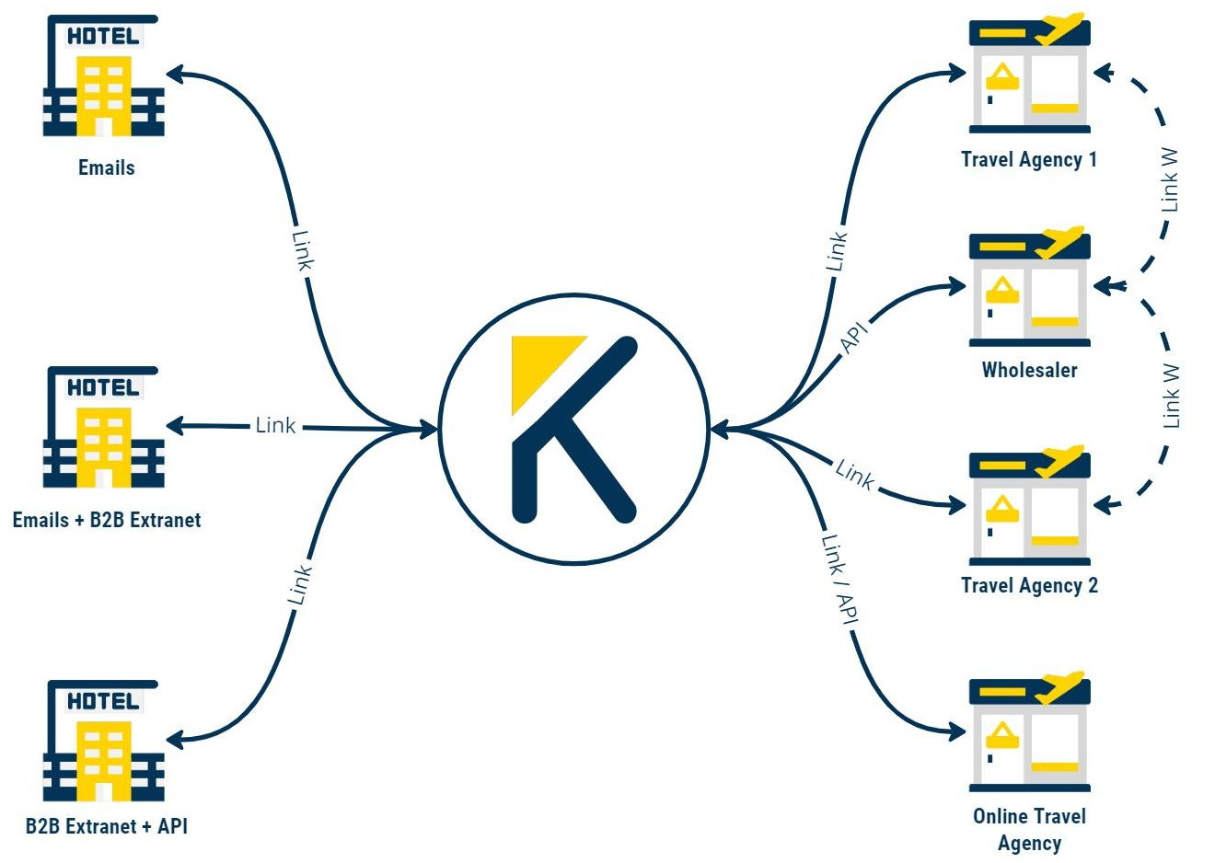
Fast & Secure
Booking Engine
More Direct
Bookings
B2B Booking
Marketplace
Instant
Updates
Notes:
We are reorganizing the workflow between different stakeholders and our model enables them to manage everything – from one single platform .
We are offering a fast and secure booking engine
where Hotels & Guest houses will get more direct bookings
and updates are made automatically everywhere

Slide 6
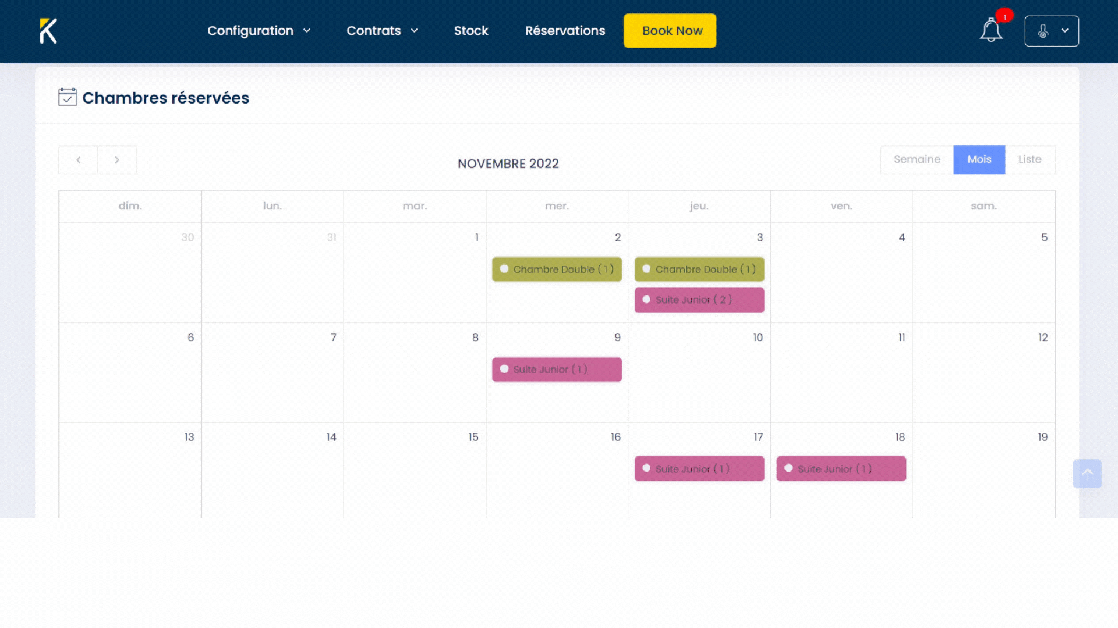
Notes:
Our solution offers hotels the possibility to set up and edit stock and prices by category of partner – in order to sell the best available rate.
and Travel Agencies will have real time updates about room availability, hotel prices, promotions and stop sales .
This allows them to develop a larger offer to satisfy their customers needs.

Slide 7
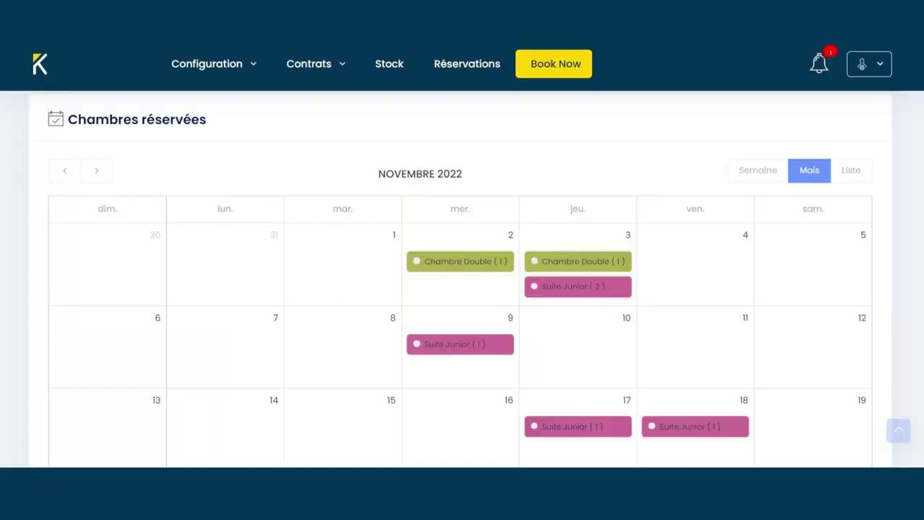
Notes:
Our solution offers hotels the possibility to set up and edit stock and prices by category of partner – in order to sell the best available rate.
and Travel Agencies will have real time updates about room availability, hotel prices, promotions and stop sales .
This allows them to develop a larger offer to satisfy their customers needs.

Slide 8
Traction
Estimated Revenue - 2022
15 000 TND
+70
Connected
Local Travel Agencies
Notes:
We officially launched during last month and we got 1 year agreement with 3 hotels to use Kinko as main selling channel with an estimated revenue of 15000 Dinars by the End of this Year and more than 70 connected Travel agencies

Slide 9
Commission Fees
Business Model
1.5 %
Hotels/Guest Houses
Free
Travel Agencies
Notes:
Our business Model is based on Commission fees fixed at 1.5% for Hotels and Guest Houses on every booking made through Kinko - and free access for travel agencies

Slide 10
Hotel Revenue 2021
$700 Million
Tunisia
$285 Billion
Worldwide
Notes:
Hotel Revenue in 2021 reached 700 million dollars in Tunisia and more than 280 billion dollars worldwide

Slide 11
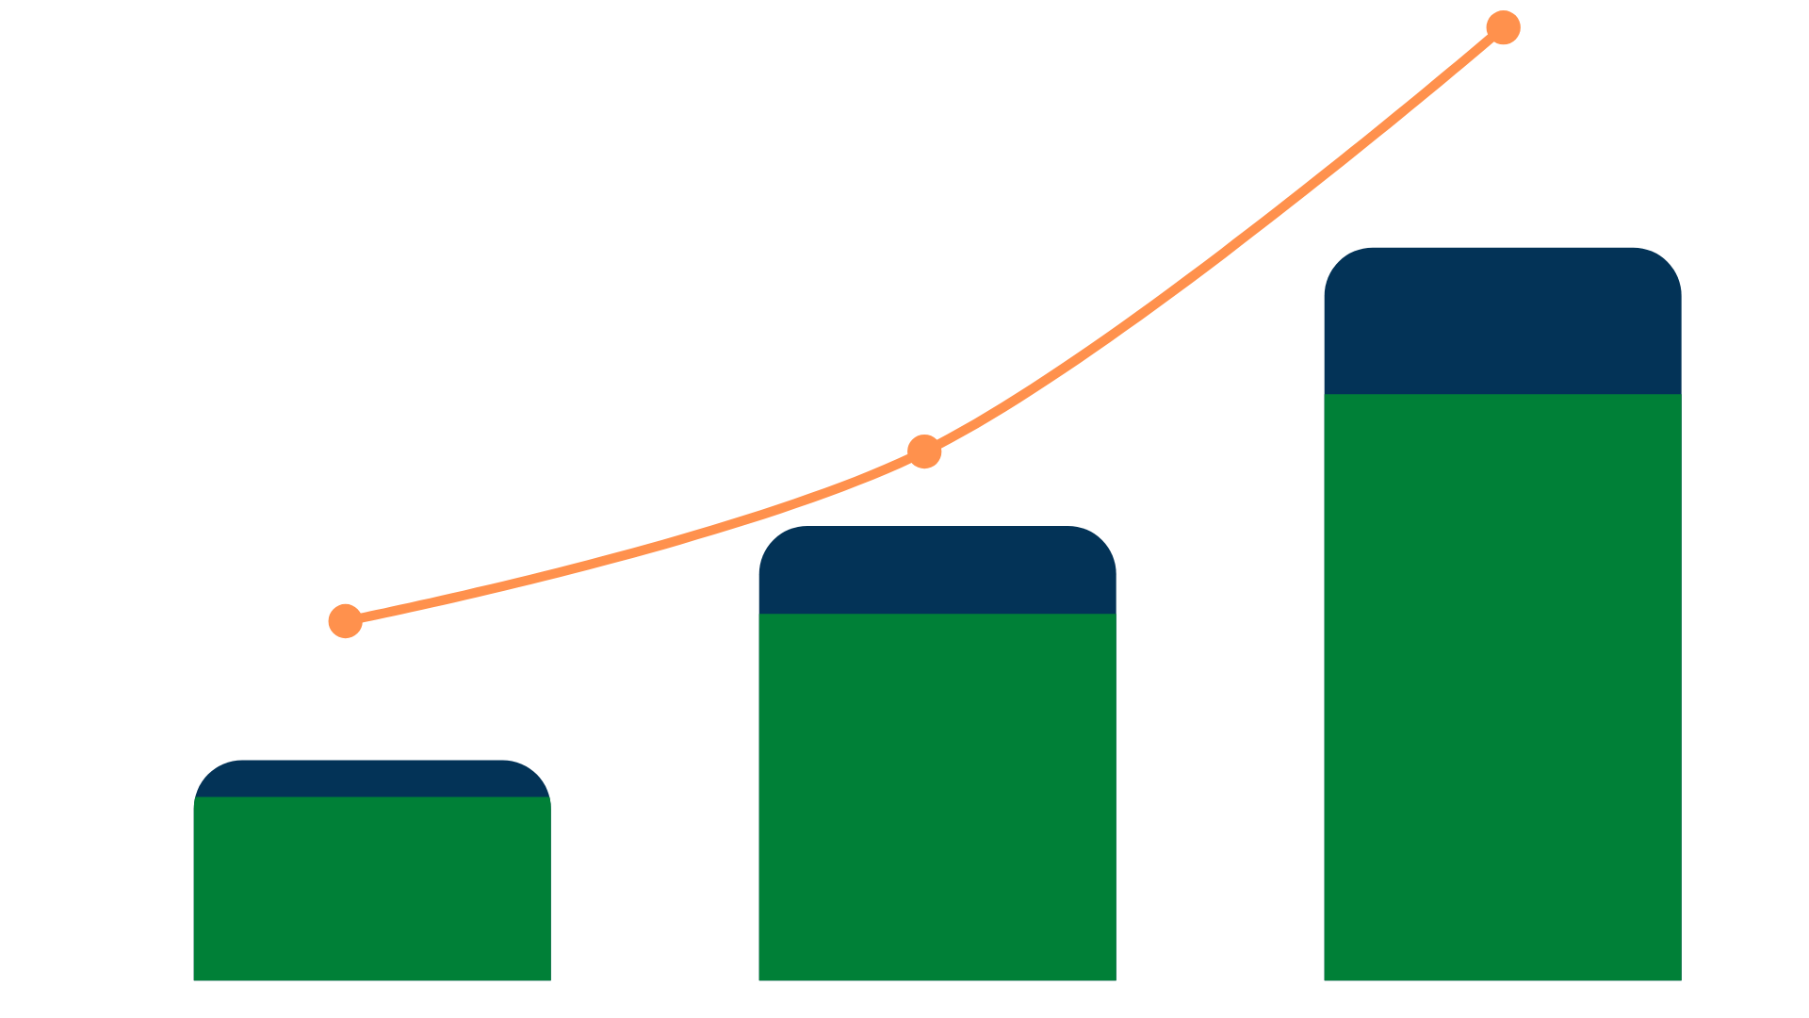
2M TND
750K TND
200
Revenue
250K TND
120
Hotels & Guest Houses
800
50
500
Travel Agencies
250
2023
2024
2025
Morocco & Egypt
Notes:
Our target is to generate 750 thousand dinars in revenue by 2024
and once we master the local market we are aiming to expand to Morocco and Egypt by 2025 - to reach 2 million dinars in revenue with 200 hotels and more than 800 travel agencies connected to our platform.

Slide 12
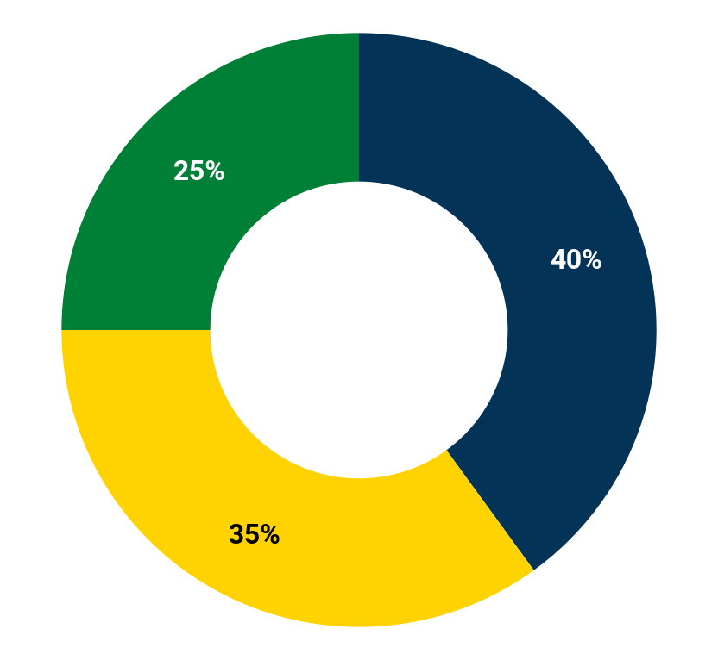
We are looking to raise a seed round of
400K TND
25%
HR
Sales Team - Helpdesk
40%
Marketing & Sales
Online Campaigns - Fairs
35%
Product Development
B2C Booking Engine & Chatbot Integration
Notes:
To reach our goal we are looking to raise a seed round of 400 thousand dinars And this will help us recruit a talented and experienced sales team.
Boost Online marketing campaigns and ensure a physical presence during fairs.
For Product development will be focusing on finishing our B2C booking engine and ensure a chatbot integration in order to increase our partners revenue.

Slide 13
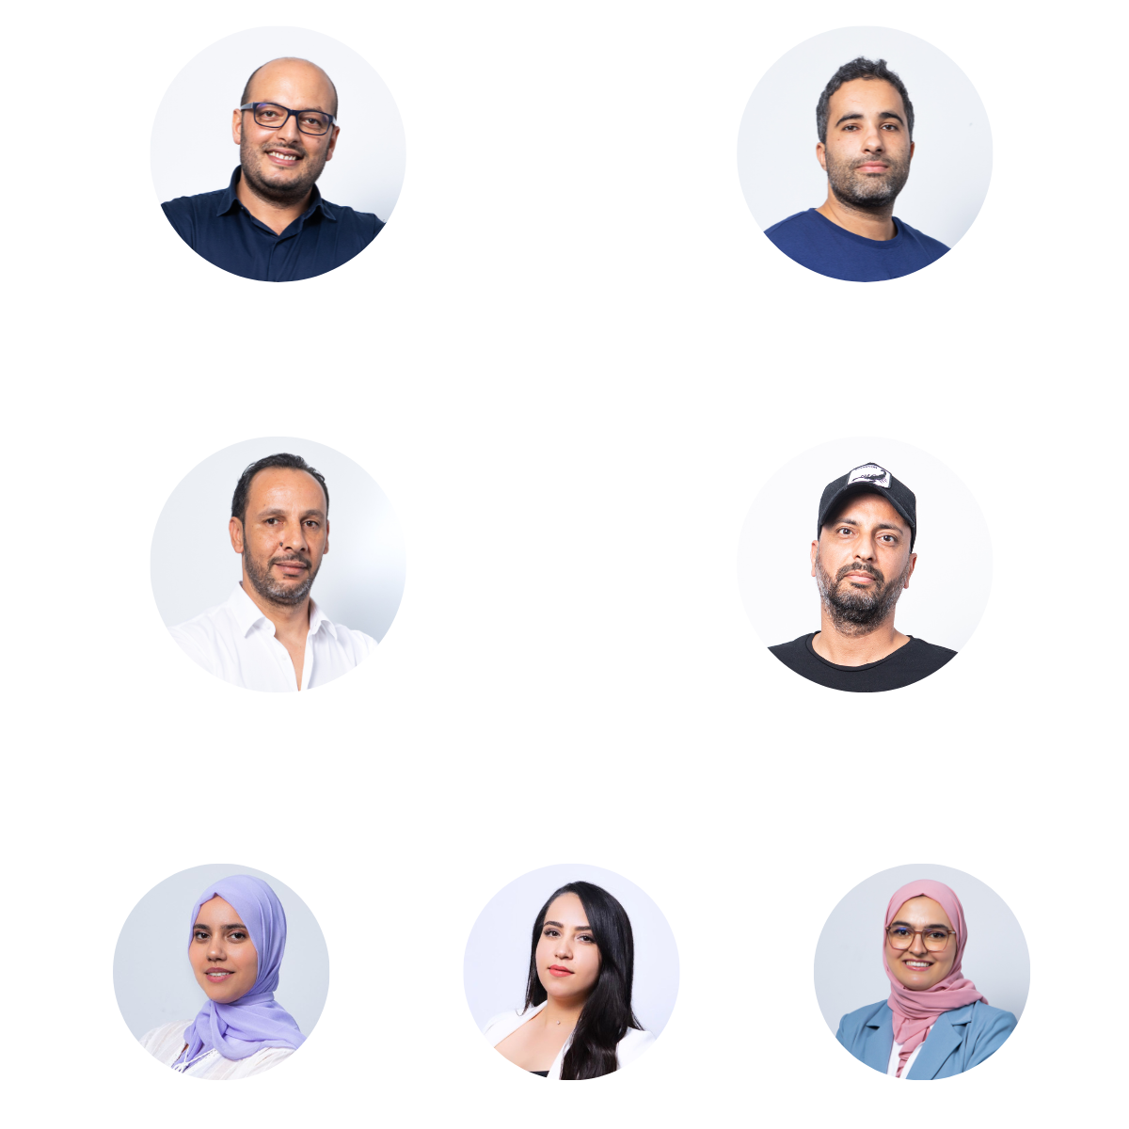
Bilel BAROUNI
Co-Founder & CEO
Mohamed Bilel KEDIDI
Co-Founder & CTO
Our Team
50 ^{years}
Cumulative Experience
Atef TURKI
Co-Founder
Nour BEN TAHAR
Co-Founder
Management - Hospitality - IT Development Marketing and Commerce .
Eya HLILOU
Sales Support
Sirine MHEDHBI
Web Developer
Amel DAGDOUG
Web Developer
Notes:
We are a team of 4 co founders supported by an amazing staff with more than 50 years of cumulative experience in Management / Hospitality / It Development / Marketing and Commerce.

Slide 14
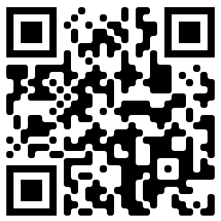
Scan the Code
& Get Your
10% Discount
Booking Differently
bilel.barouni@kinkobooking.com
kinkobooking.com
+216 29 85 00 65
Notes:
We built Kinko to reshape the hospitality sector
And we are offering 15% discount for our guests today through our B2C booking engine which will be ready next January .
Just scan the code, fill the form and Meet us at our booth to discuss more
Thank you

