Slide 1

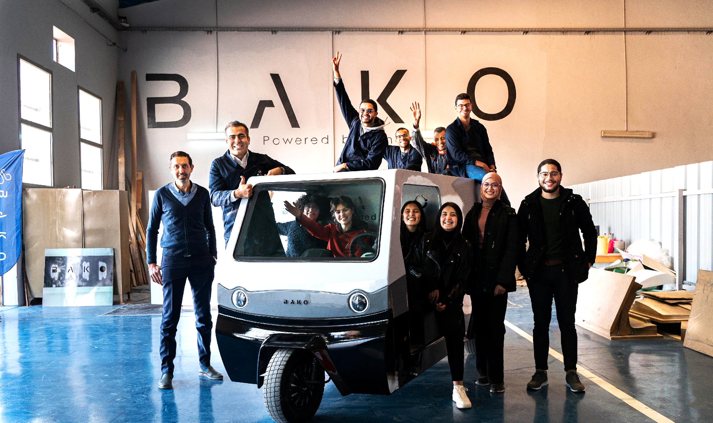







ACCELERATED BY:
Notes:
Hello everyone ! I’m Boubaker, Co-founder and CEO of Bako Motors

Slide 2
Issues for Last-Mile Delivery
4k USD
Average shipment cost of one vehicle from Asia to Africa
Notes:
Did you know that car purchasing in Africa costs twice the price in Europe.
You might ask why? Well It’s definitely due to two main issues:
the high custom taxes
high transit costs.
As a reference, the shipment cost of one vehicle from Asia to Africa is more than 4000$.

Slide 3
Issues for Last-Mile Delivery
4k USD
3 Months
Average shipment cost of one vehicle from Asia to Africa
Average time to get your car repaired
Notes:
On top of that, in Africa, it can take you more than 3 months to get your car repaired.

Slide 4
Issues for Last-Mile Delivery
4k USD
3 Months
2k Kg
Average shipment cost of one vehicle from Asia to Africa
Average time to get your car repaired
Of CO2 emissions by one fuel car per year
Notes:
Olsssssssso, each fuel car generates more than 2000 kg of CO2 per year,

Slide 5
Issues for Last-Mile Delivery
4k USD
3 Months
2k Kg
55%
Average shipment cost of one vehicle from Asia to Africa
Average time to get your car repaired
Of CO2 emissions by one fuel car per year
Increase in Motor Fuel Prices between January and June 2022
Notes:
And Most Importantly:
We are facing high operation costs due to the constant increase of fuel prices – up to 55% in the last 6 months

Slide 6
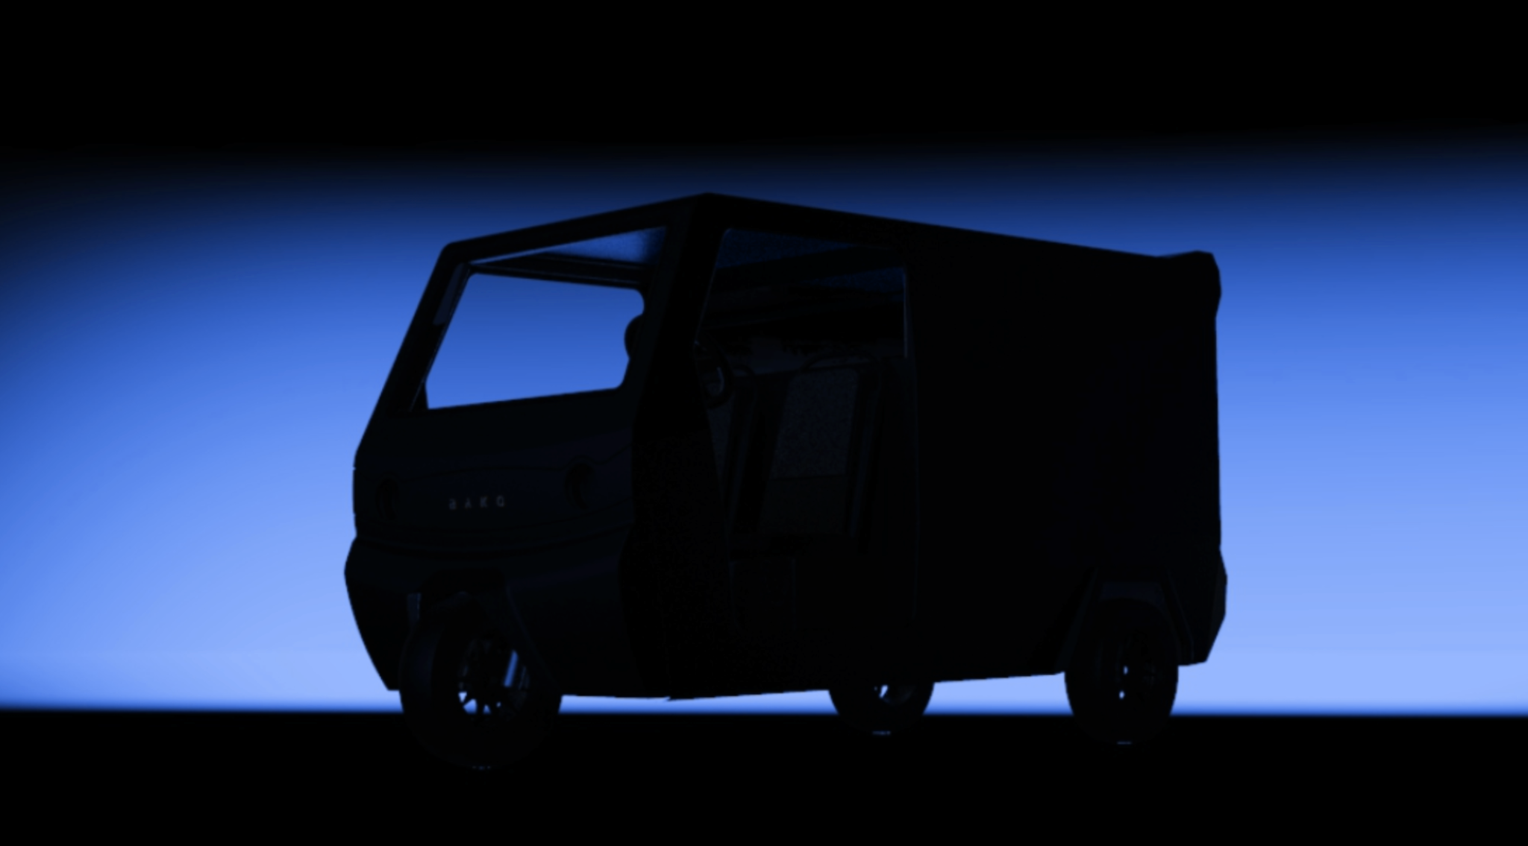

Bako Motors have developed and manufactured the first Electric Vehicle powered by solar energy In Africa.
Notes:
For these reasons, at Bako Motors, we have devAloped and manufactured the first Electric vehicle powered by solar energy In Africa.

Slide 7
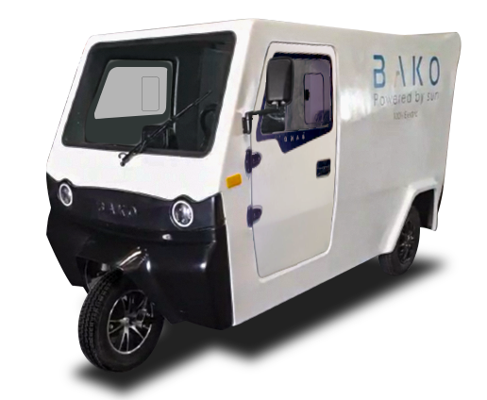
A Car charging itself
350 KM
Per week of free charging thanks to the photovoltaic solar cells.
Notes:
We have created something Different: a Car charging itself !
350 KmZ per week of free charging thanks to the photovoltaic cells,

Slide 8
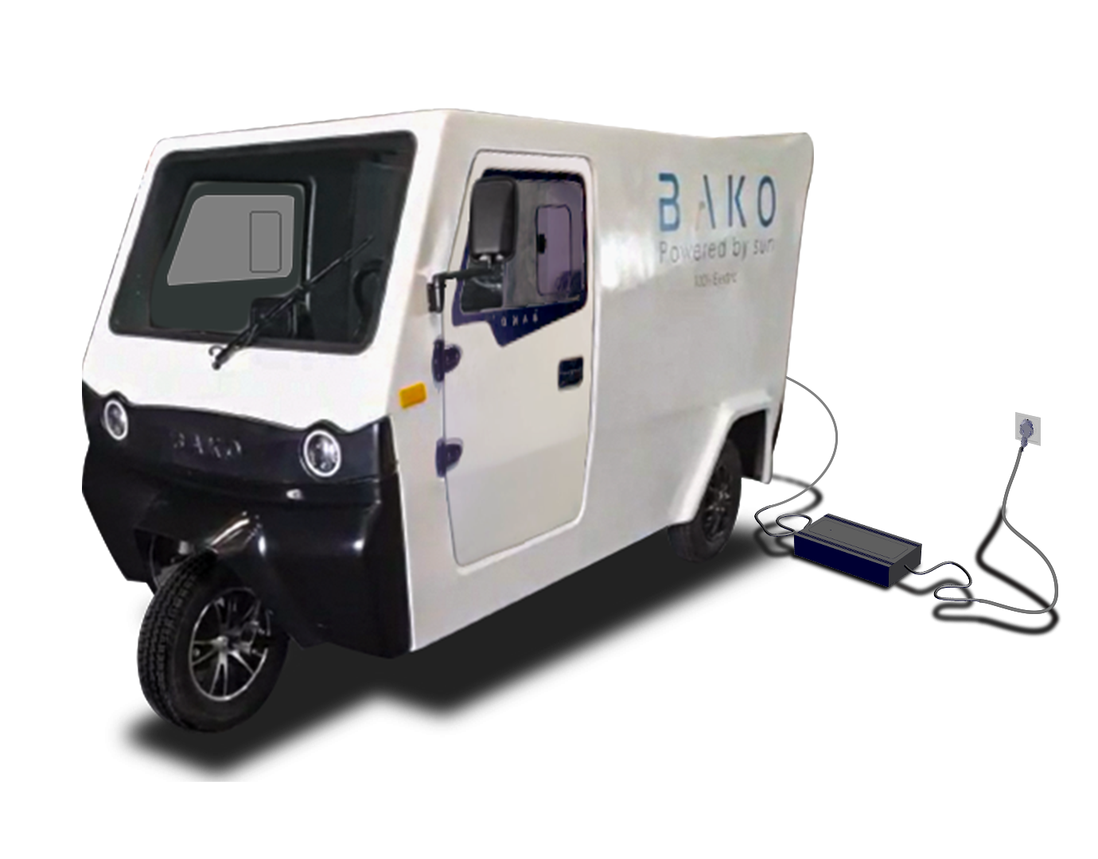
A Car charging itself
350 KM
3 Hours
Per week of free charging thanks to the photovoltaic solar cells.
Of charging time from the domestic sockets.
Notes:
It can be fully charged within 3 hours from the domestic sockets.

Slide 9
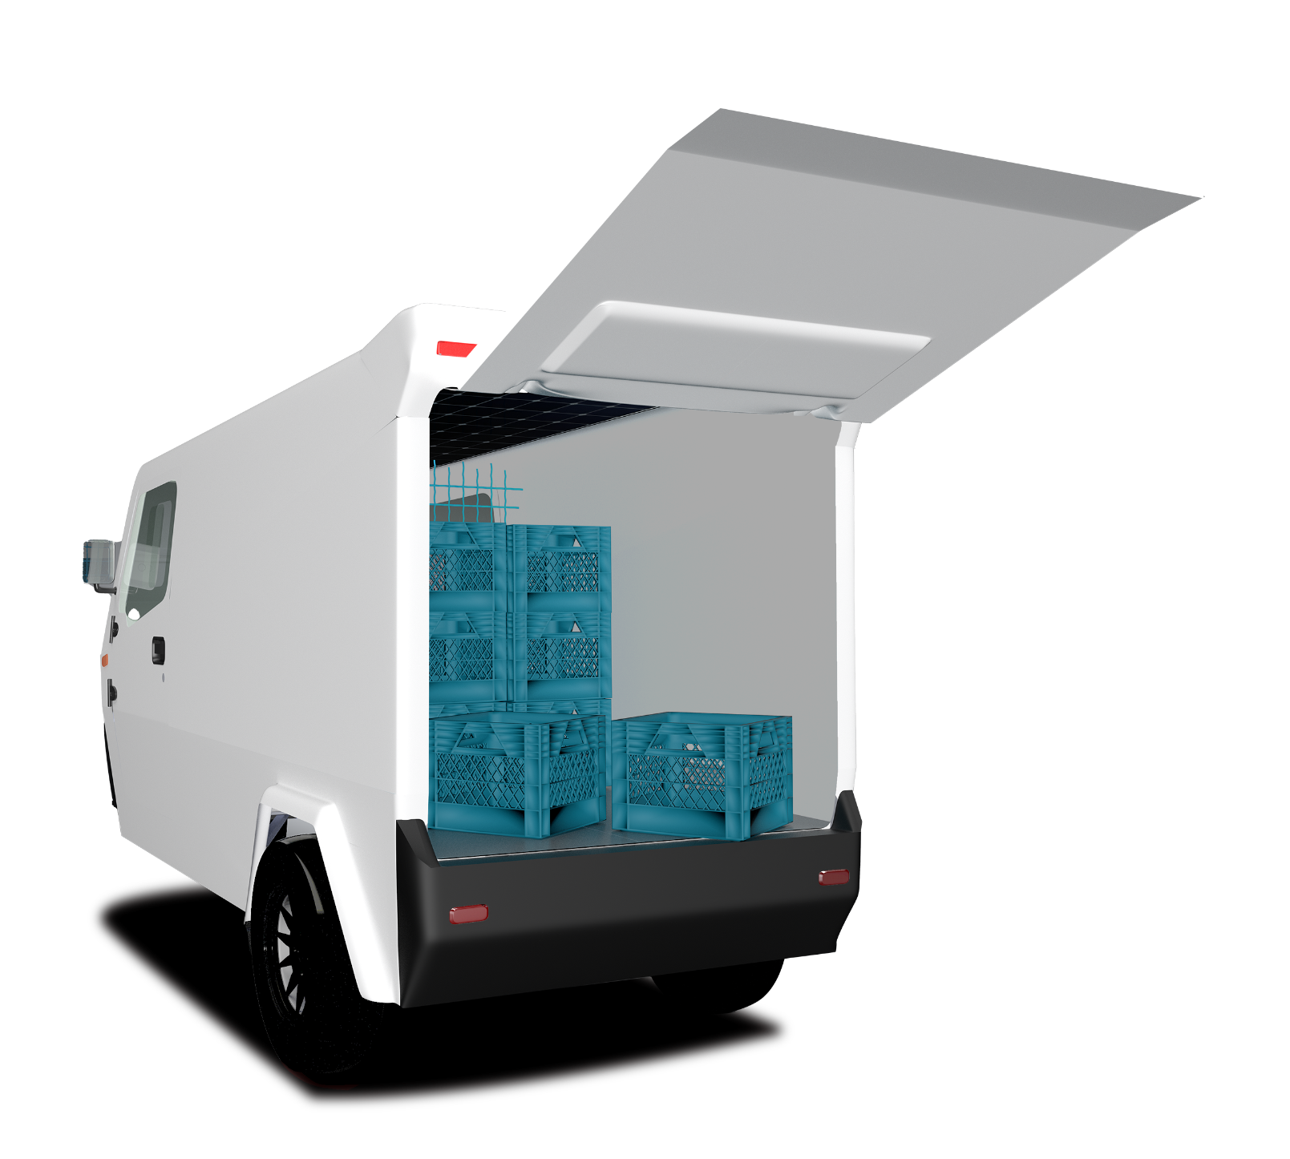
A Car charging itself
350 KM
3 Hours
2000 L
Per week of free charging thanks to the photovoltaic solar cells.
Of charging time from the domestic sockets.
Of Loading Area.
Notes:
We have created something Different: a Car charging itself !
350 KmZ per week of free charging thanks to the photovoltaic cells,

Slide 10
A Car charging itself
ONLY $0.5/100km
Bako’s Transport Cost
10X times cheaper than fuel vehicles
Notes:
We are Olssso offering our customers a large loading space of 2000Litters

Slide 11
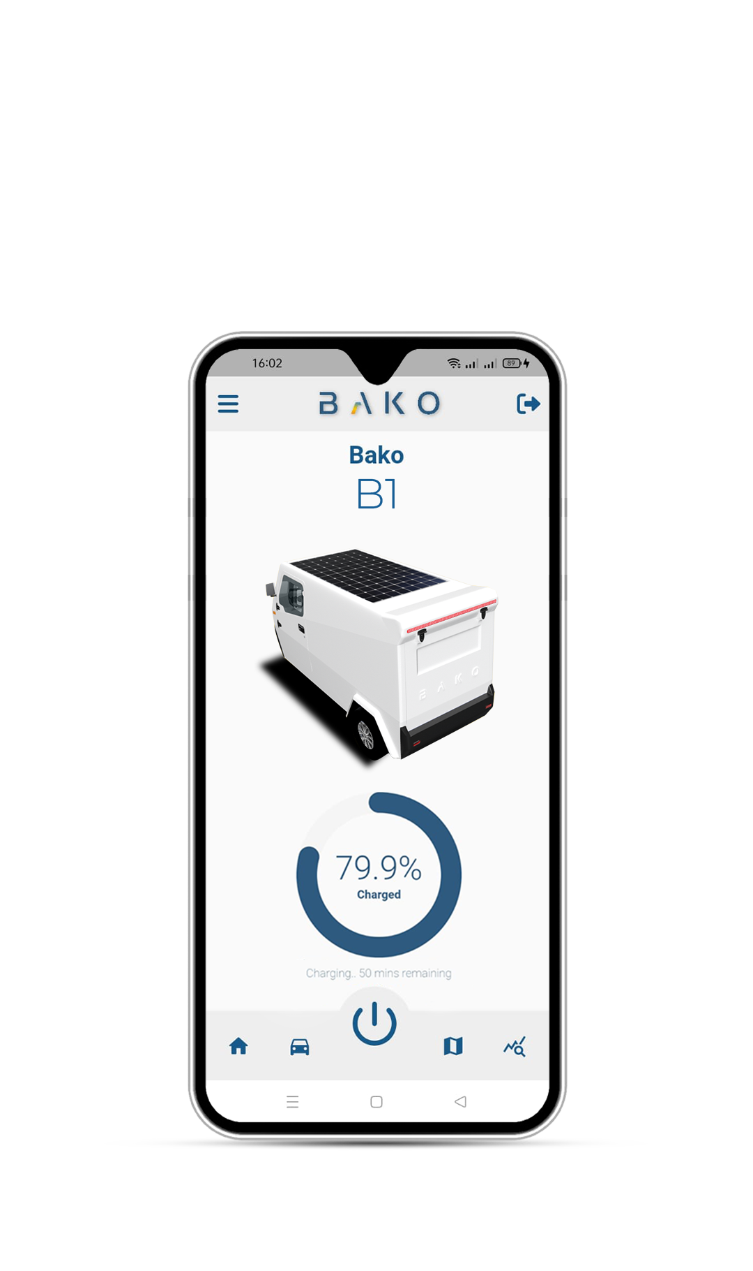
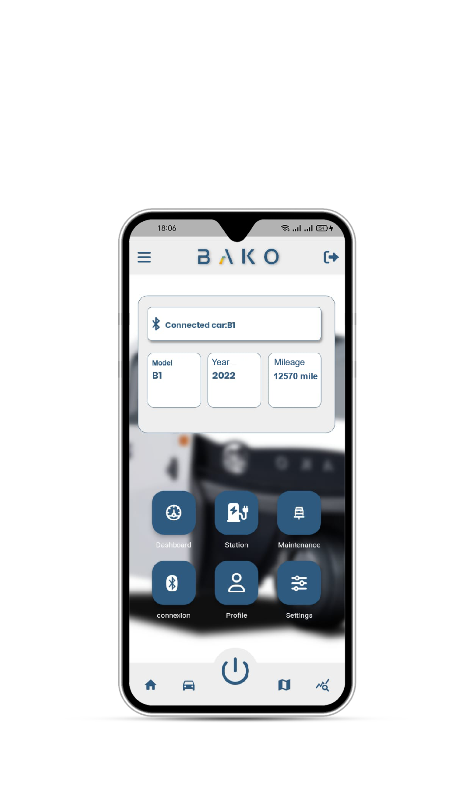
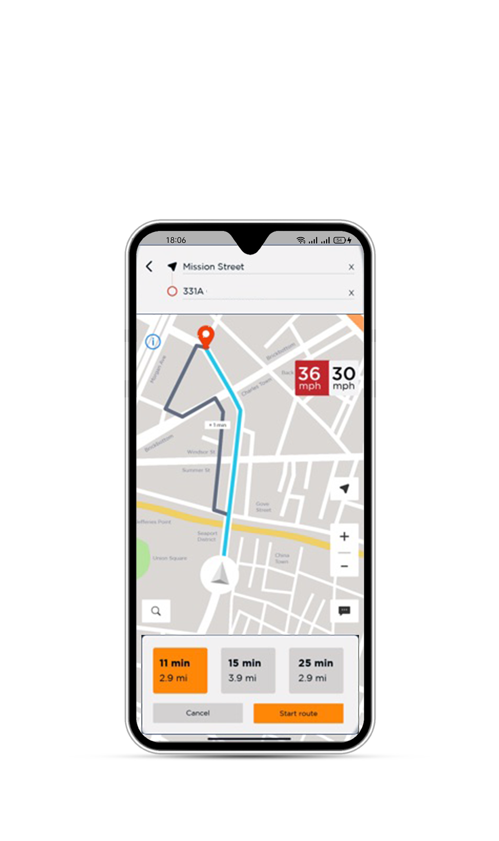
You can track your car and check its status
Notes:
Our GPS Tracking system connected to our BAKO App, allowZ the fleet manager to monitor and check his vehicle status.

Slide 12












They trust us
92 Pre-orders
Notes:
So far, We secured 92 pre-orders worth 1.3M TND in revenues.
We are aiming to deliver our first vehicules before the end of the year.

Slide 13















Our Target End-Clients
Leading brands across Logistics, E-Commerce, Food Delivery and other sectors
Logistics
Fast Moving
Consumer Goods
E-Commerce
Food Delivery
Notes:
Our target customers are mainly the last mile delivery companies,
small business owners, fast food restaurants and transporters.

Slide 14
Market Size of Electrical 3-Wheeler
$ 15.5B
Global Market
Our Target by 2025
1% Market Share : $ 150M
Notes:
The global Market of the E 3 Wheelers is worth 15.5B $.
By the end of 2025, we are targeting 1% of market share after expanding our operations and sales across the EMEA Region.

Slide 15
Business Model
B10 - 100km
B15 - 150km
B20 - 200km
12K TND
15K TND
18K TND
Notes:
We are selling three types of vehicles starting from 12K TND - depending on the battery capacity

Slide 16





Business Partners
International Brands
Local Suppliers
B10 - 100km
B15 - 150km
B20 - 200km
400 TND
483 TND
580 TND
Leasing /month
Notes:
In order to reach our high standards, We have established strategic partnerships with international brands like Bosch, Marquart and Local suppliers like Amine and Assad, which allow us to achieve more than 60% of local integration.
And to facilitate the payment for our customers, we closed a partnership with Zitouna Tamkeen and Enda Tamweel.

Slide 17
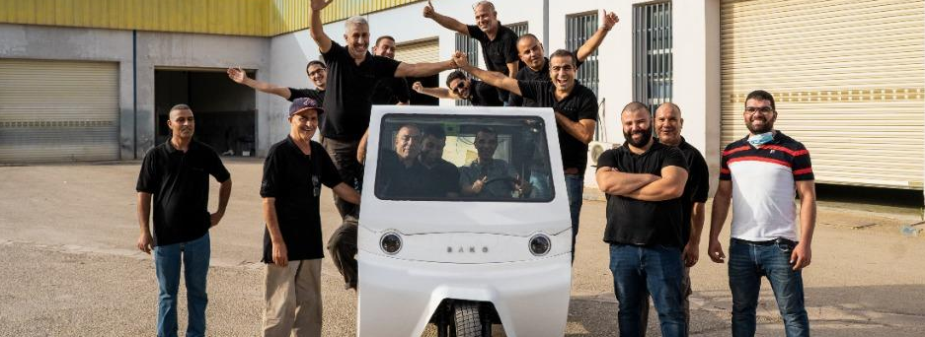
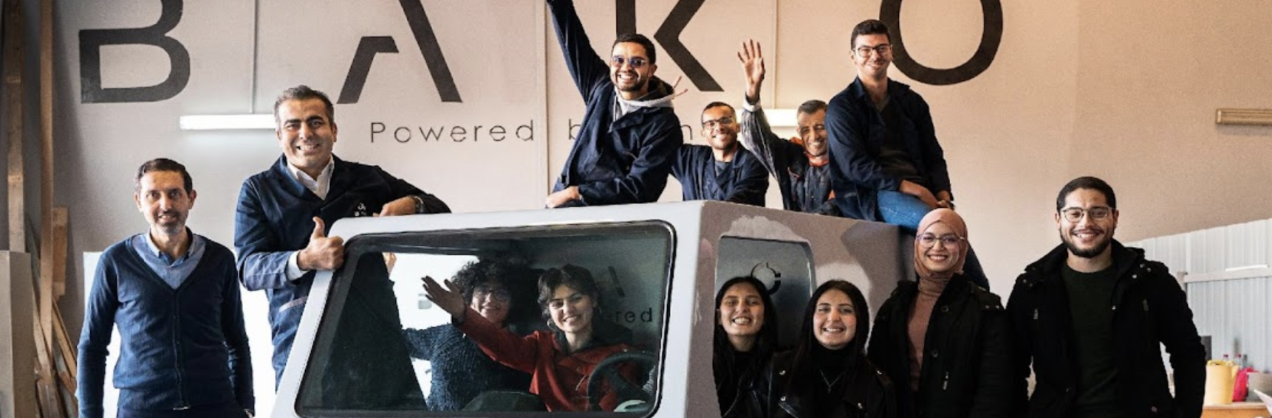
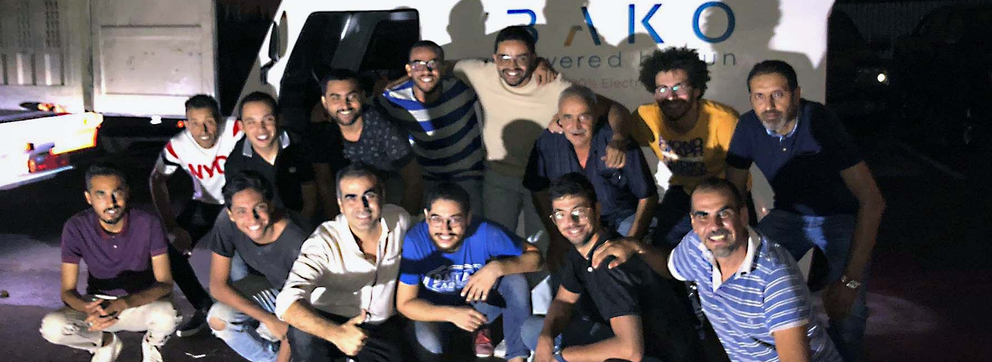
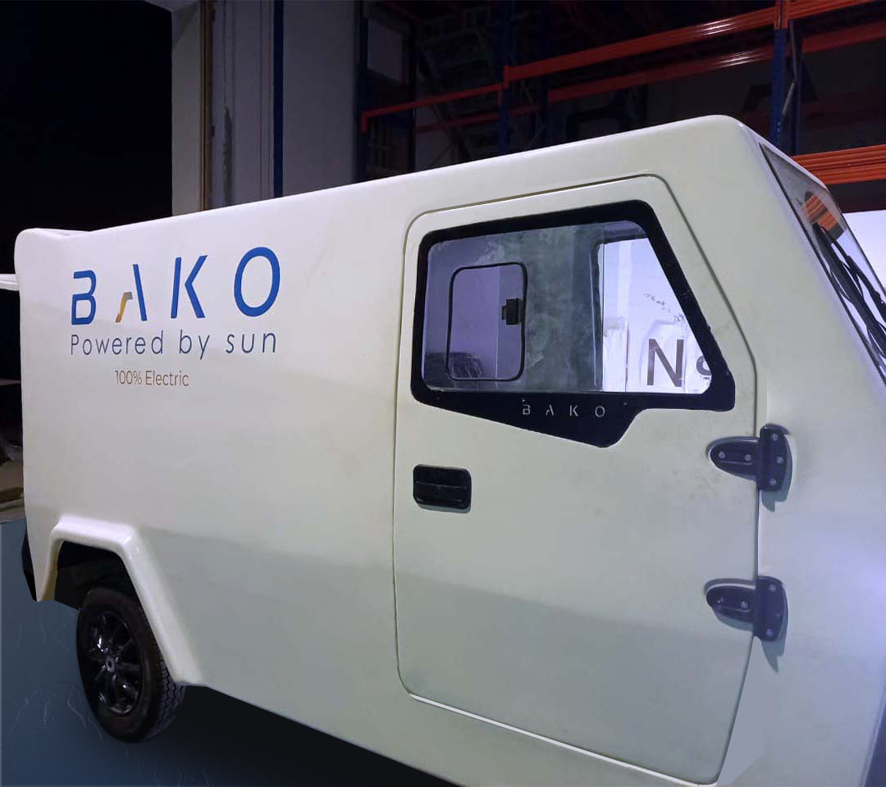
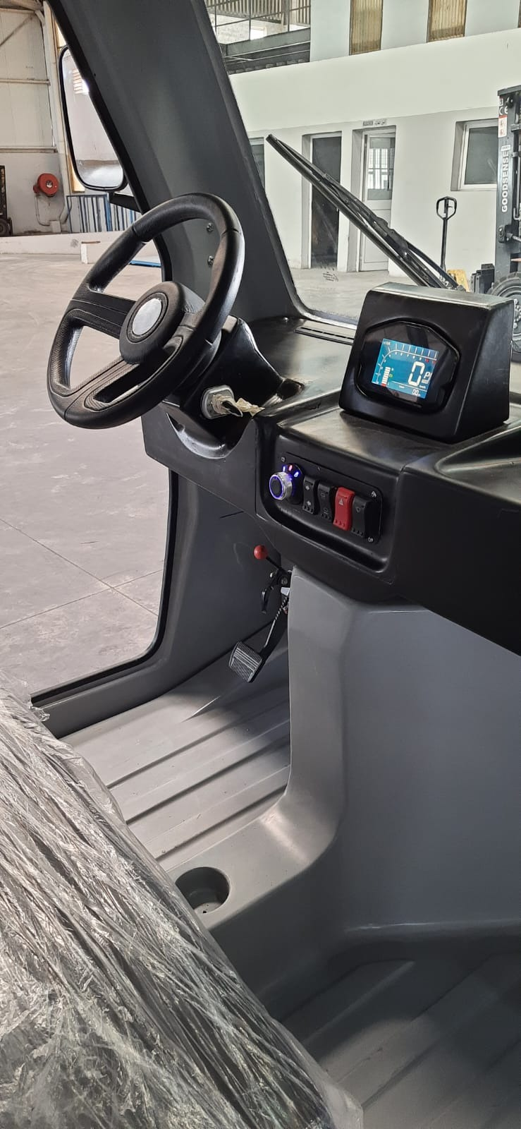
Bako Motors in just 1 year
Sept 2021: POC
Jan 2022: Prototype
Sep 2022: Pre Series
Certification CE
4 Employees
11 Employees
25 Employees
Notes:
And this is how it started:
Back in Sept 2021 with only 4 employees, we managed to develop our first POC.
So far, we expanded our team to 25 full time employees and started certifying the vehicule and producing the pre-series.
●

Slide 18
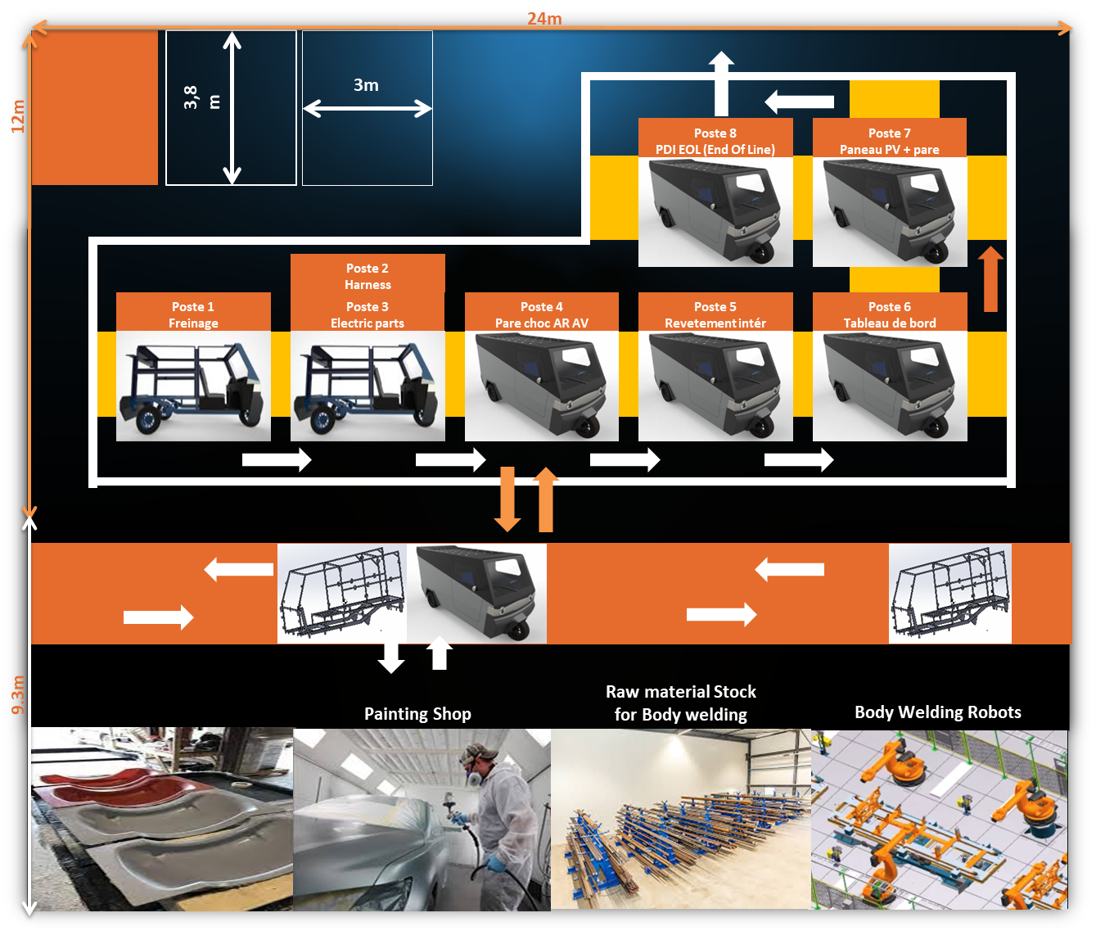


Micro Factory 1000sqm
Production capacity per year: 100 vehicles
Homologated and certified in Europe
Vehicle and production plant process
Notes:
We believe that sustainable mobility should be available to everyone - that’s
Why - we have homologated our production line process -
allowing us to duplicate our factory and enable local production.
Soon, Egyptians will produce their cars for Egyptians.

Slide 19







Expansion Roadmap
Our tech and tests partners
2022
Factory
2024
2023
Sales and R&D
2023
2026
Notes:
To achieve that goal, we established serious partnerships with well-known manufacturers - we can already expand our activities to Cairo, Riyad and lagos.

Slide 20


Expansion Roadmap
2023
2024
2025
50 Employees
200 Employees
800 Employees
Release of 4-wheeler car.
Units sold: 600
Revenue: 8M TND
Release of golf car.
Units sold: 2300
Revenue: 25M TND
Release of mini truck.
Units sold: 9000
Revenue: 80M TND
Notes:
Next year, we aim to launch the 4-wheeler, and reach a total revenue of 8M DinarZ.
In 2024, we will release the golf car model and sell more than 2000 unitZ
And by 2025, we target to achieve a total revenue of 80M DinarZ.

Slide 21
Ask
We already raised 900k Euros
30%
Sales and Marketing
40%
Expansion and Development
5M EUR
For the Next 12 Months
30%
Equipment
3D KuKa Robot
Notes:
We have already raised 900k EUR
And we are looking to raise 5M EUR for the next 12 months

Slide 22
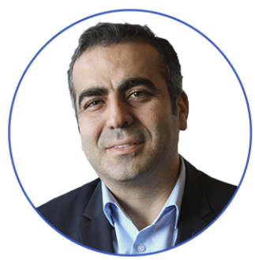




Leadership Team
Boubaker Siala
CEO
Khaled Habaieb
COO
•17+ years in Automotive Industry
•Former BMW Manager
•Founder of PV and SW Companies
•Technical University of Munich
•15+ years in Automotive Industry
•Automotive Lean Management
•Technical University of Munich
Notes:
When It comes to the executive team,
Mr Hbaieb and Myself, with more than 30 years of experience in the automotive industry

Slide 23



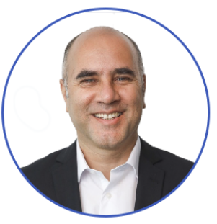
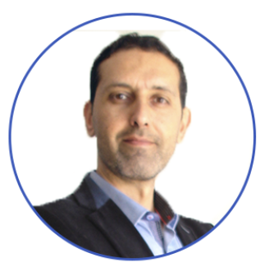
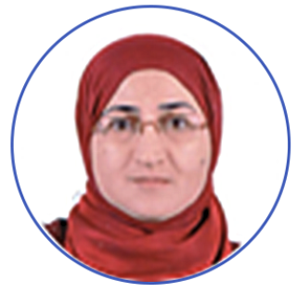


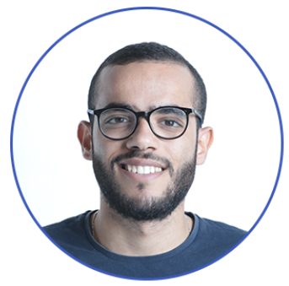
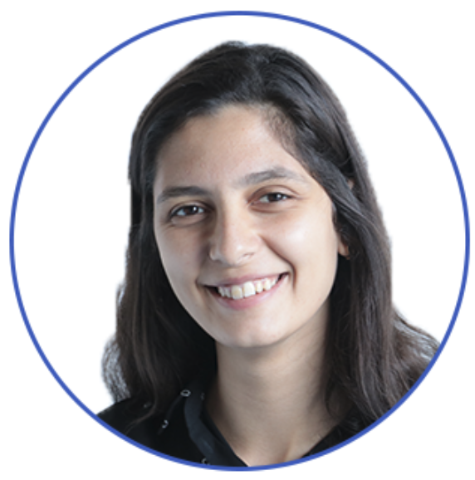

Committed Team
Hichem Radoine
Majdi Ben Ahmouda
Omar Hadhri
Project Manager
8+ years in Automotive Industry
Khaled Ben Driss
CFO
Product Manager
CTO
•17+ years in Finance
•15+ years in Automotive Industry
•Contributed to the Exterior Design
of Porsche, VW, AUDI
•Technical University of Berlin
•30+ years in Automotive Industry
Mondher Zouari
Kawthar Njah
Malek Hattab
Walid Kanoun
Med. Ali Selmi
Asma Jradi
Marwen Ktari
Production Planning manager
Purchasing Manager
Design Manager
Mechatronics
Manager
Quality Manager
Finance Manager
Marketing manager
Notes:
This adventure won’t be possible without a committed team with various expertise in Design, Production, Mechatronic and IT

Slide 24
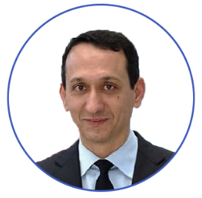
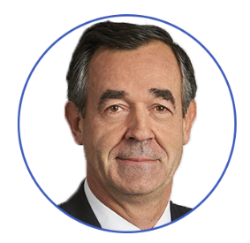
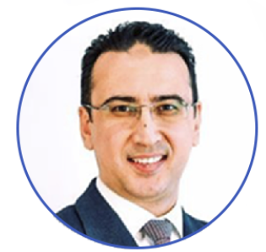



Advisory Board
Mehdi Tekaya
Xavier Urbain
Heni Jallouli
CEO WEVIOO
Logistics expert
CFO JAHEZ
30+ years in Automotive Industry
Central University of Paris
15+ years in Automotive Industry
Contributed to the Exterior Design of Porsche, VW, AUDI
Technical University of Munich
IPO of 216 Mio.$ in Saudi
Notes:
We are also grateful to have Mister Mehdi Tekaya, Xavier Urbain and Heni Jallouli as our advisors, helping us in our path to scale.

Slide 25
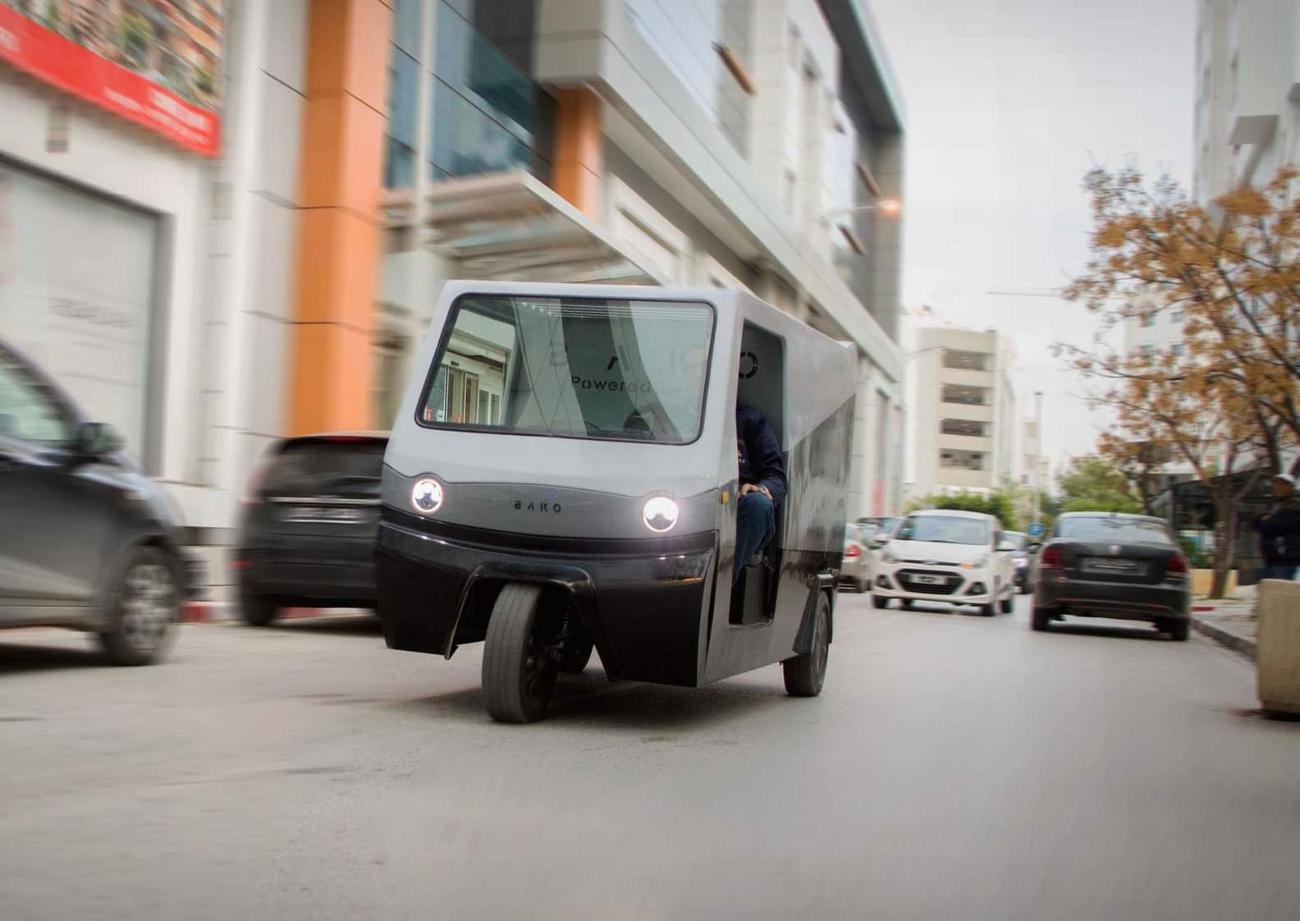

Pre-order on:
Bakomotors.com
On site: Autoroute Tunis-Sousse, sortie Hammam-Lif (MAN factory)
info@bakomotors.com l +216 31 324 045
ACCELERATED BY:
Notes:
Thank you for your attention, and looking forward to seeing you at our booth to meet our car.

