Slide 1
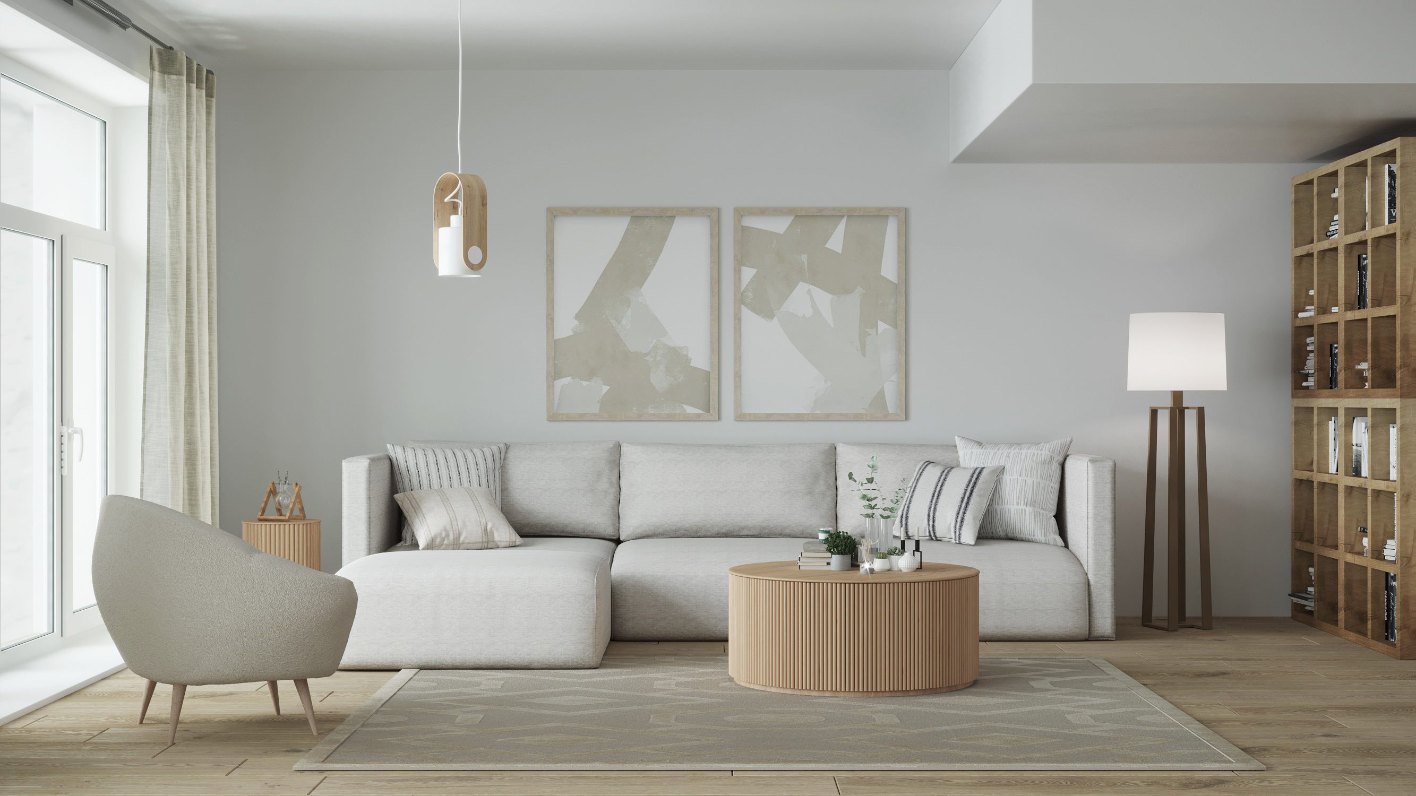

THE FURNISHING EXPERIENCE REINVENTED
Notes:
Hi, I am Othmane, the Co-Founder of MAKAN

Slide 2
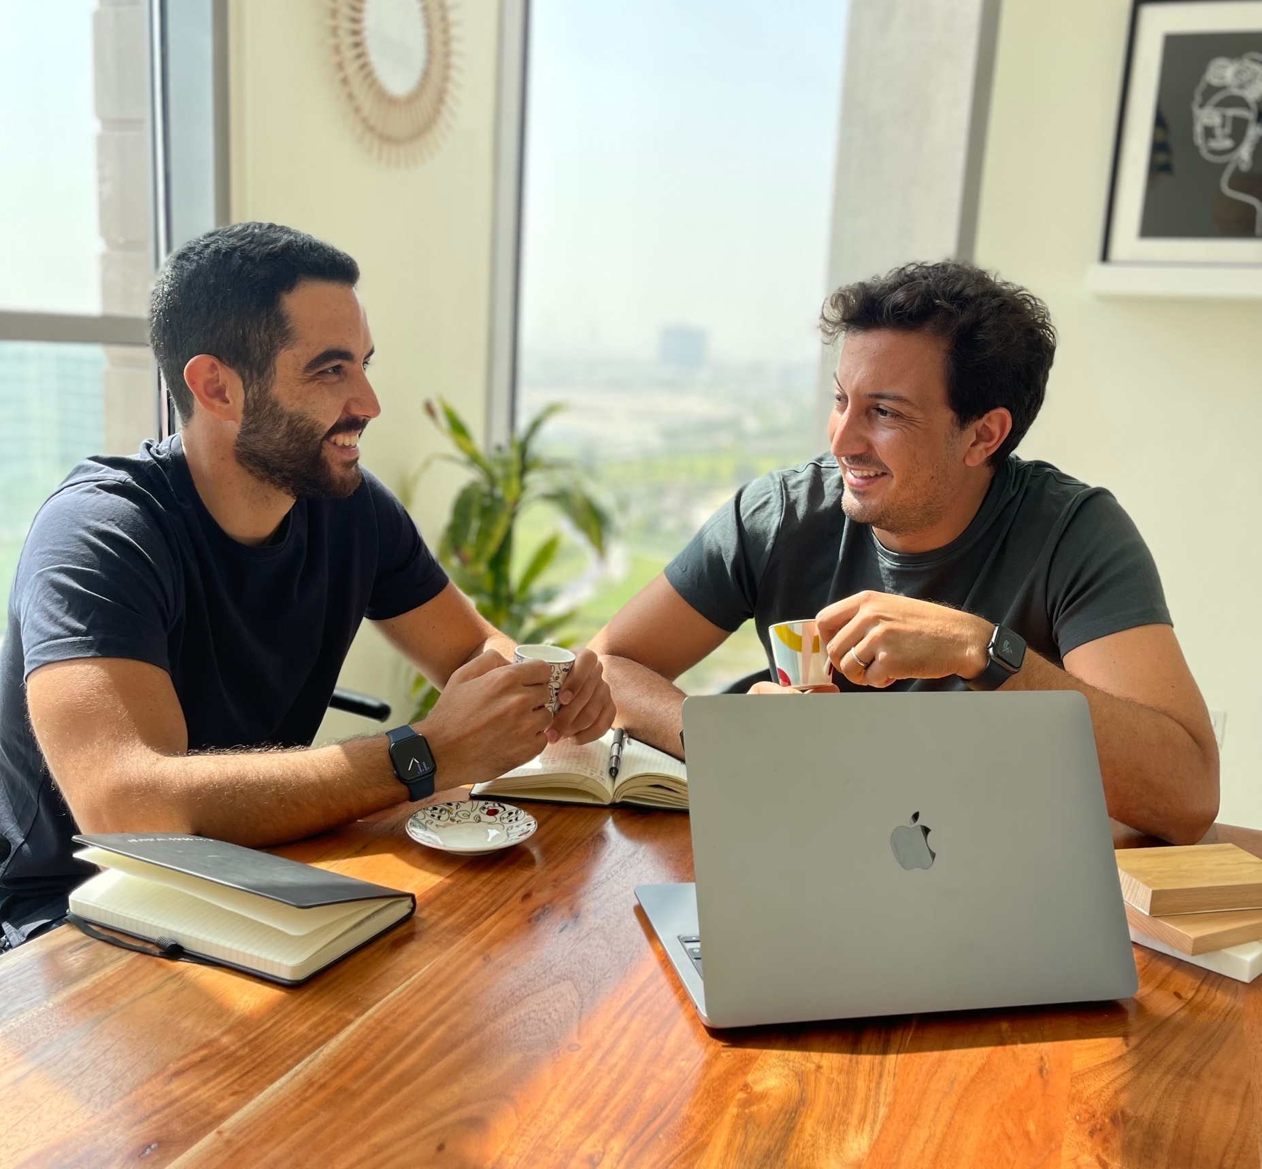


WHO WE ARE
Youssef Sekkat
Othmane Saifaoui
Ex – Manager
Ex – Manager
Notes:
With my cofounder Youssef, we have been consultants for 7 years before, and as consultants, we moved a lot

Slide 3



THE PROBLEM (1/2)
Renters stay on average 18 months in their homes
Founder’s story:
2011
2022
Paris
Singapore
Paris
Dubai
Dubai
Studio
Studio
3-bed
2-bed
1-bed
1- bed
1-bed
1 bed
2-bed
with mates
with mates
as couple
as couple
Singapore
Paris
Paris
Dubai
“In total, more than 40k USD spent in furnishing 9 different places”
Notes:
Over the last 10 years, I moved 8 times, never spending more then 2 years in the same place, and I spent more then 40,000 USD to furnish these places

Slide 4
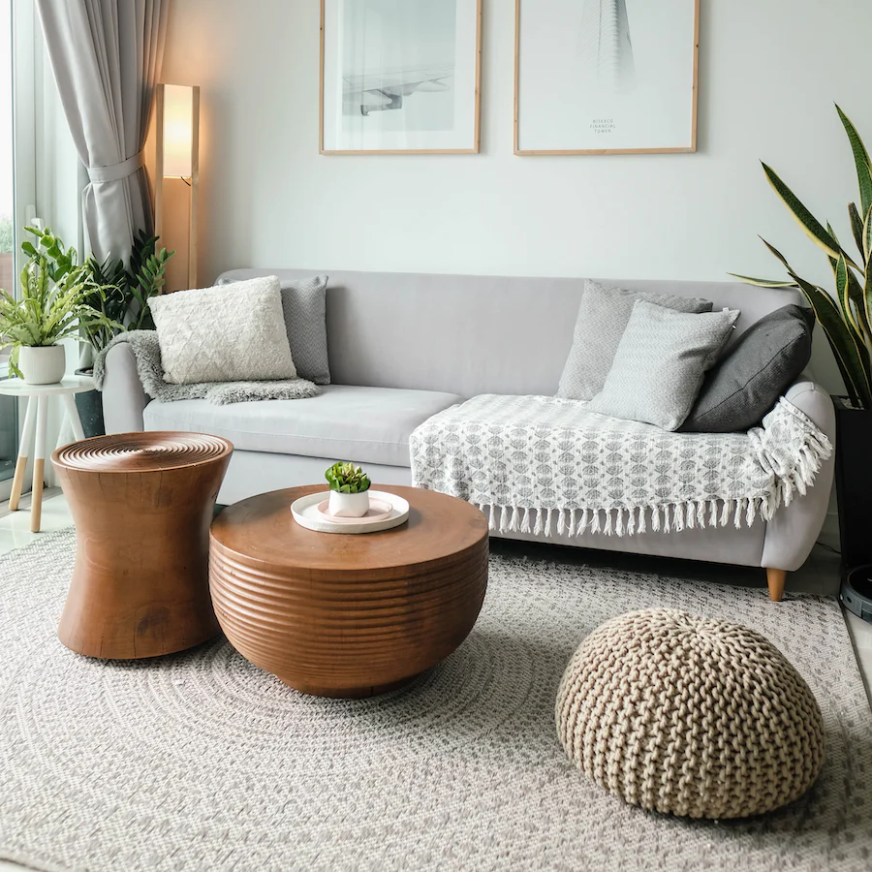
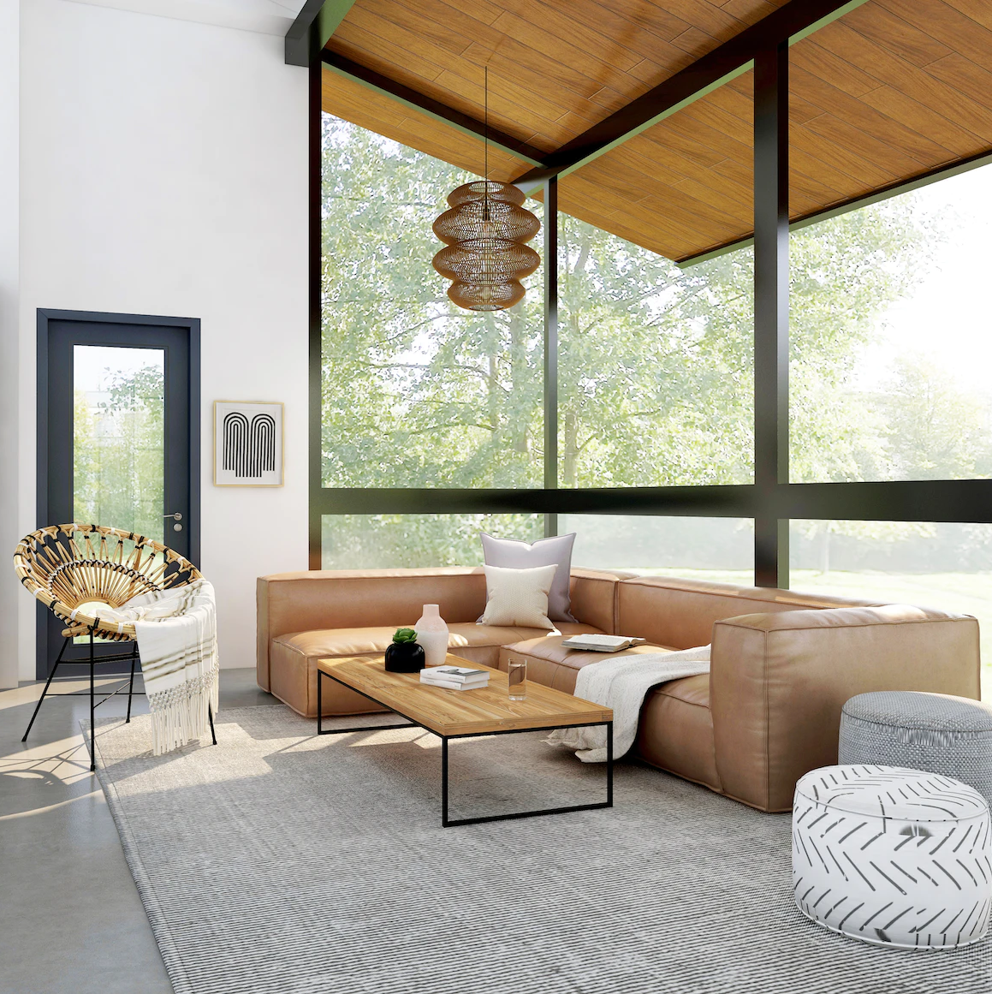

THE PROBLEM (2/2)
Buying and owning furniture always comes with the same issues
Financial commitment
Time commitment
Strong depreciation cost & hassle
USD 15K
paid upfront to buy
furniture for a 1-bedroom
2 months
To source all
furniture needed
USD 2K
from selling back furniture when moving out
Notes:
Each time, buying and owning furniture came with the same issues. When I moved from Singapore to Paris:
I had to pay 15K USD upfront to buy my furniture
It took me 2 months to find all the furniture I needed
And the worst part of it is probably when I had to move out 12 month later. I made only 2K from what I was able to sell, and dumped all the rest on the street
Owning furniture is always a hassle

Slide 5


THE PROBLEM
Millenials are owning less and renting more, yet no company has addressed furniture yet
Transportation
Careem, Uber
Entertainment
Anghami, Spotify, Netflix
Furniture
Home
Blueground, Sonder
Electronics
Grover
Clothing
Rent the Runway
Notes:
Overall millenials are realizing that ownership is a scam, they are owning less and renting more
- Companies are making millions out of this shift: in transportation with Careem, or in entertainment with Spotify
- Yet, nobody addressed the furniture vertical, until now

Slide 6
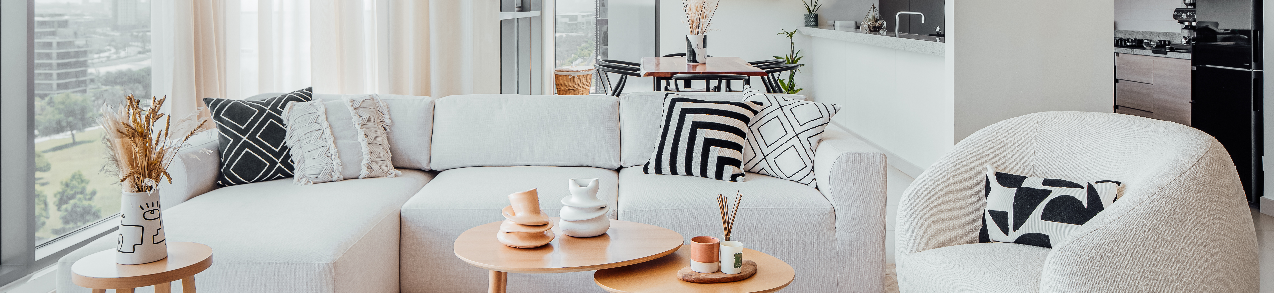

THE SOLUTION
MAKAN, a furniture rental service reinventing the furnishing experience
Premium
furniture
for rent
Monthly
payments
with rent-to-own
Free
delivery
& assembly
Curated by our
inhouse designers
Flexbility to return the furniture or
rent-to-own it, if rented for 24 months
No-hassle service,
in less than 7 days
Notes:
MAKAN is a furniture rental service with:
Premium furniture for rent, curated by our inhouse designers
Our customers don’t pay anything upfront, they pay monthly with the flexibility to return or rent-to-own furniture if they keep it for 24 months
And we are committed to offer free delivery and assembly, in less than 7 days

Slide 7
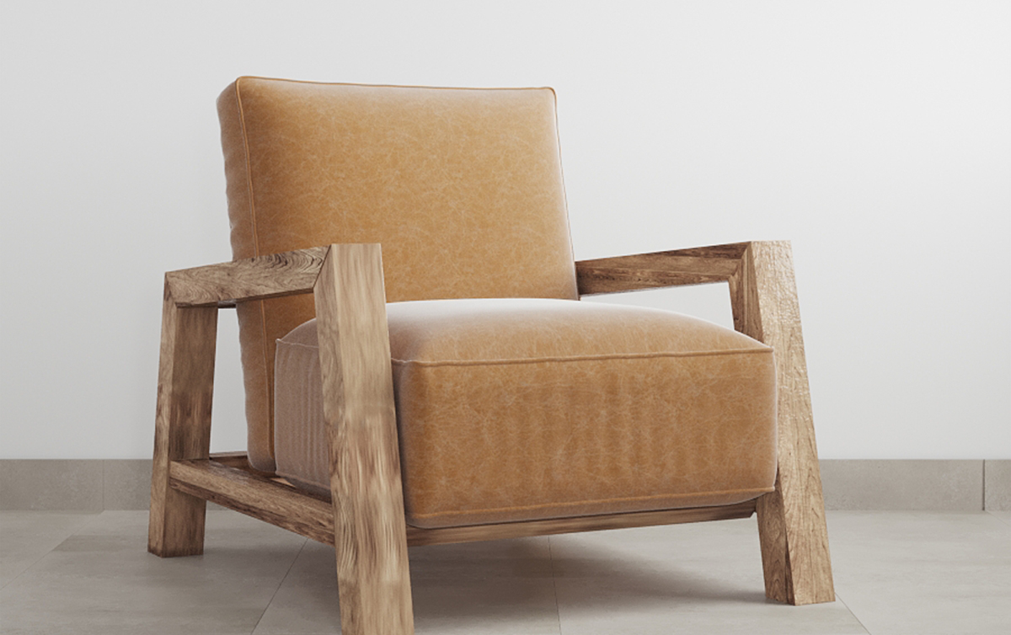
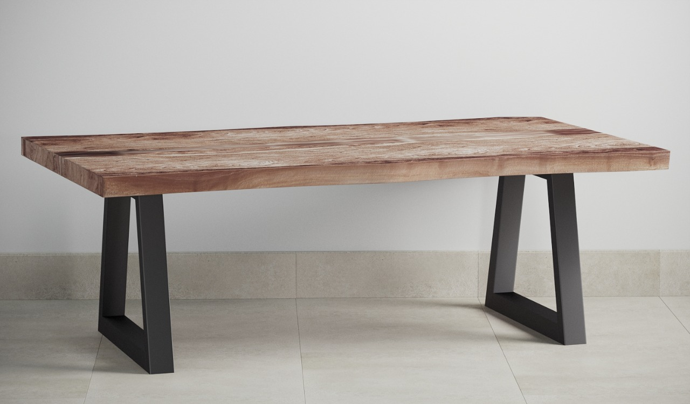

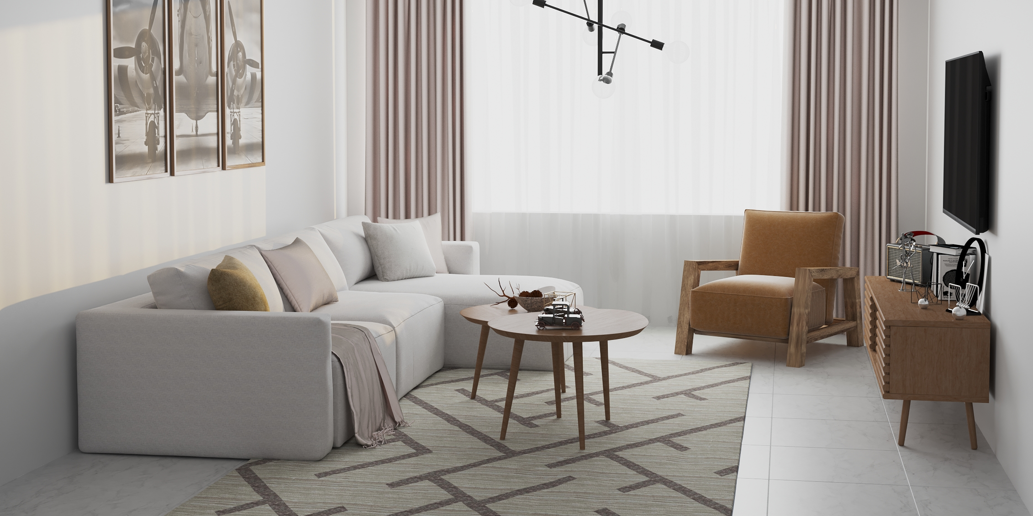
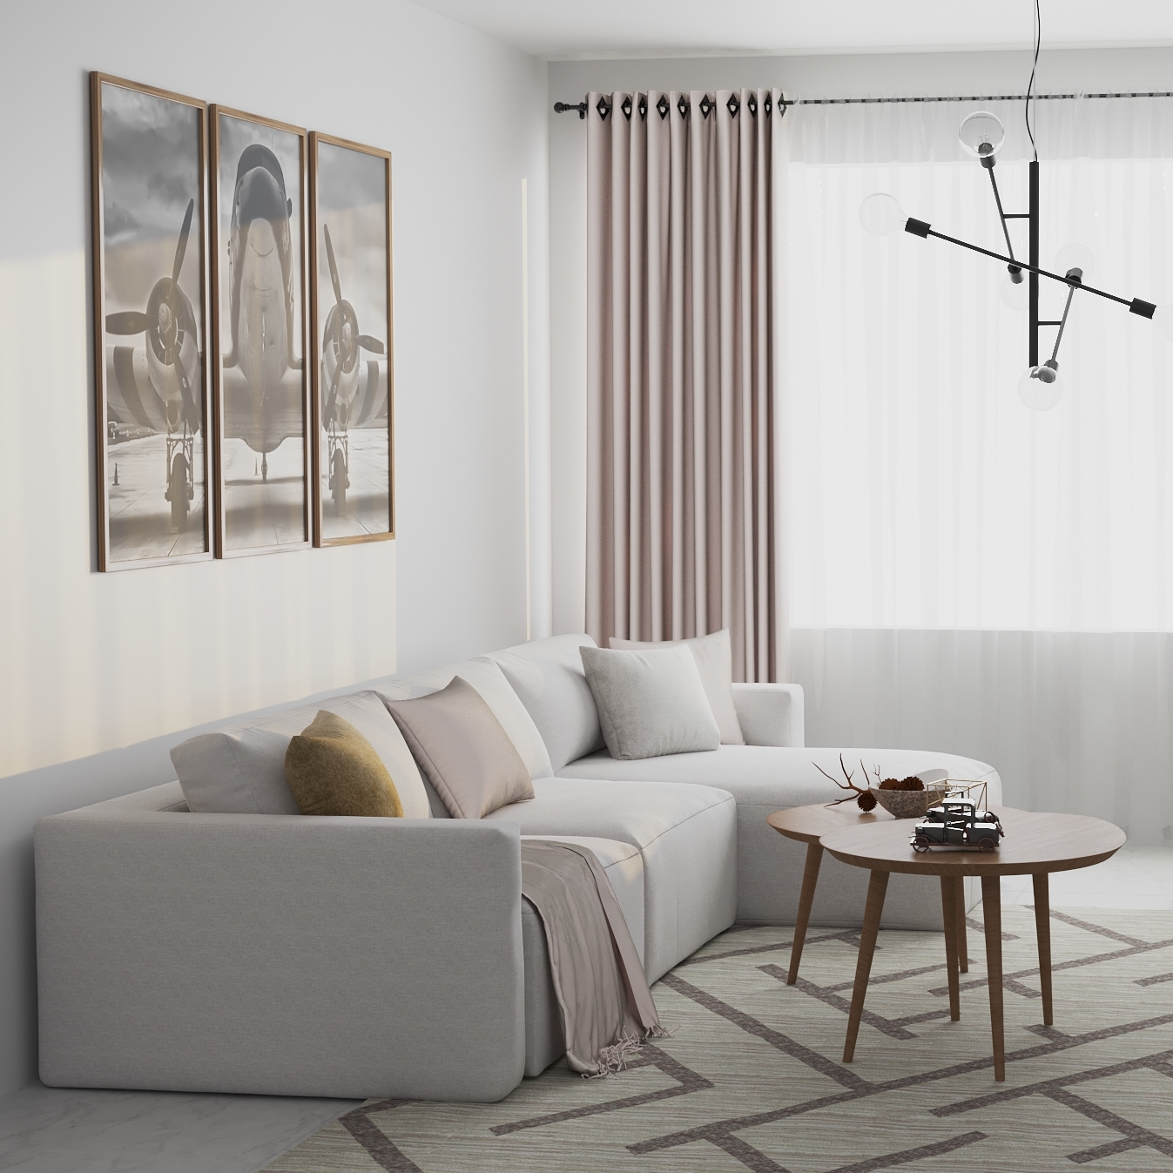
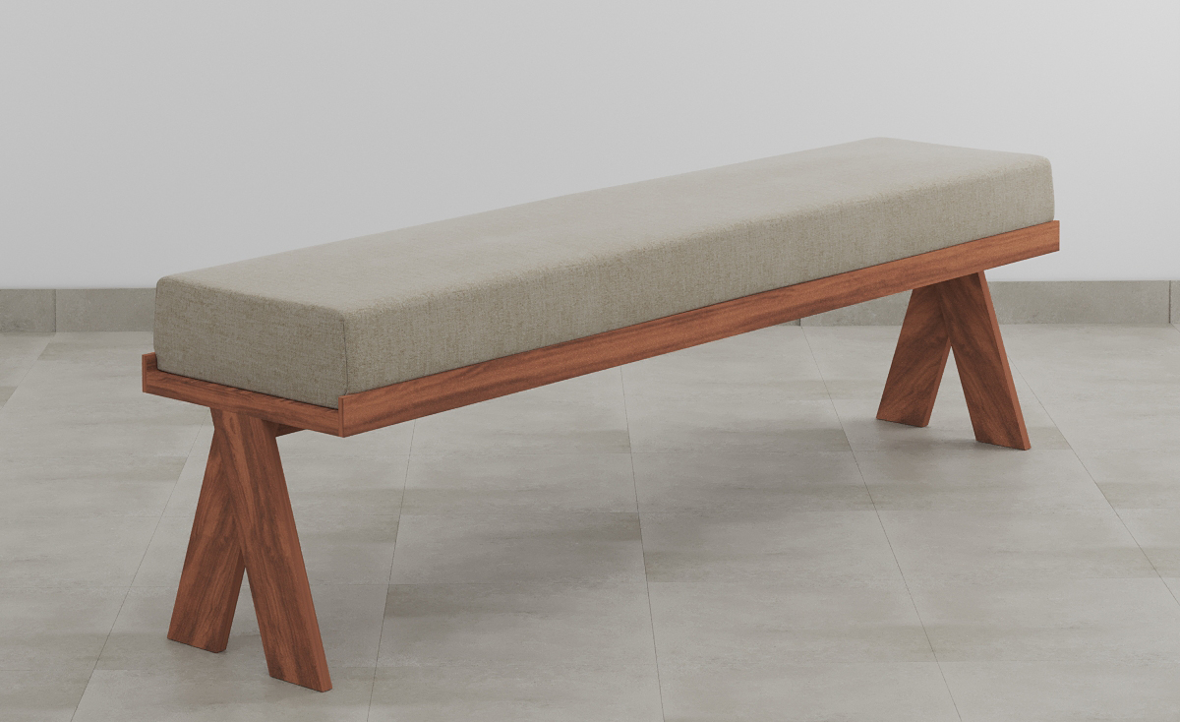
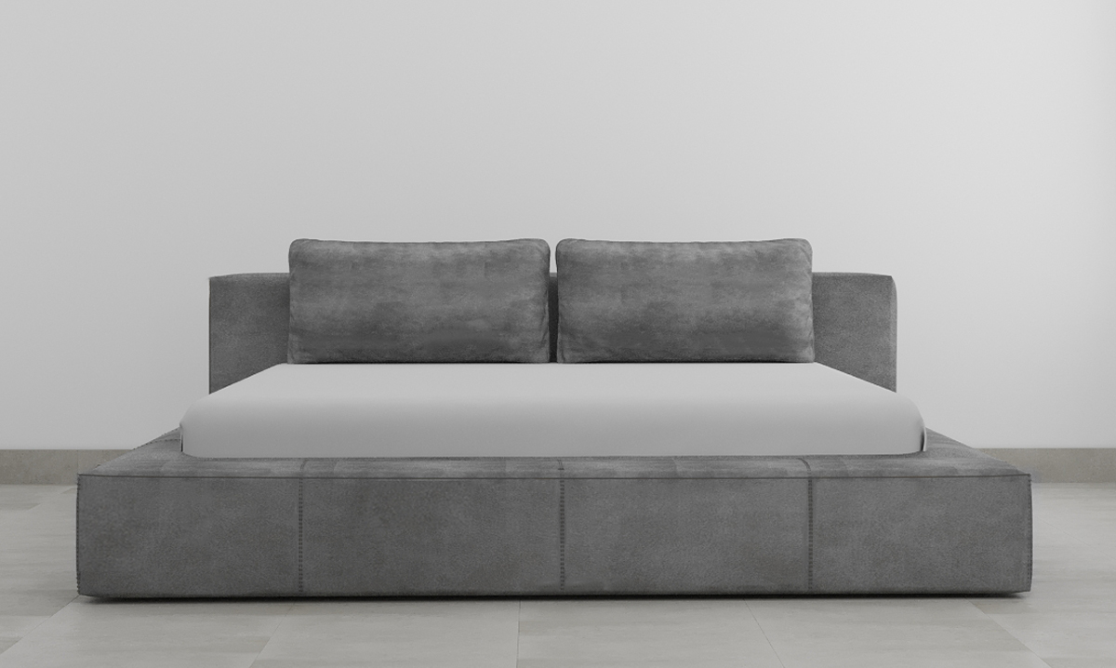
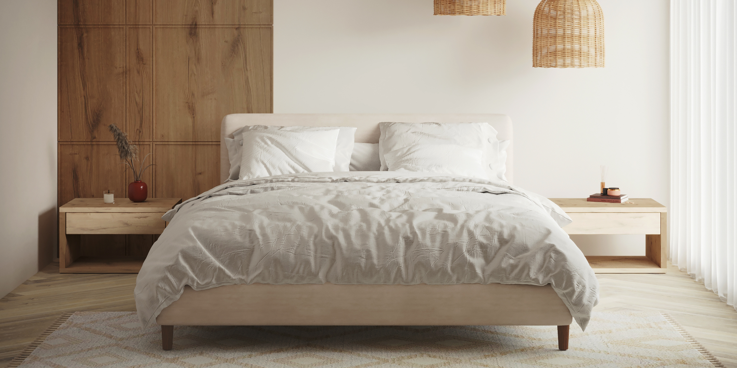

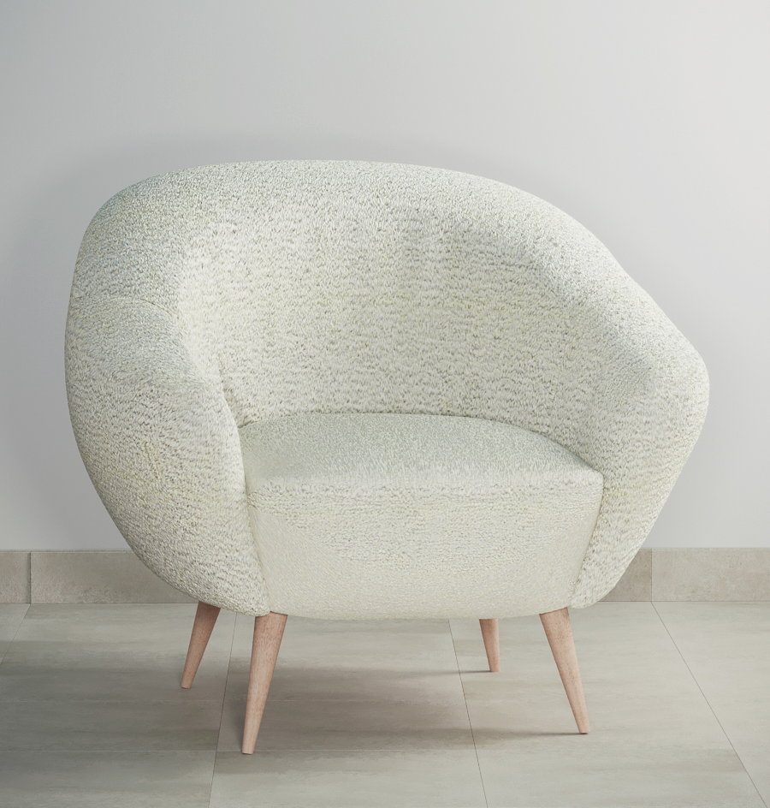
THE SERVICE
MAKAN offers different furniture rental options
150
individual items for rent
15 pre-curated rooms,
with different styles (modern, industrial, etc.)
Studio to 5-
bedroom villas
The Noah Sofa
USD 80/mo
The Notebook Bundle
USD 140/mo
One Bedroom Apartment
USD 300/mo
Notes:
Our customers can rent
indivdual pieces, like a sofa for 80 usd per month
Bundles, package for entire rooms created by our designers, with different syles: Modern, Industrial or Bohemian
or they furnish their entire home from a studio to a 5 bedroom villa
On average it would cost 300 USD / month to furnish a one bedroom appartment with a living room, dining room and bedroom

Slide 8




BUSINESS MODEL
Revenue comes from furniture rentals, for up to 5 years. A $1K sofa can generate up to $5K
Year
2
Rent-to-own model
Revenue generated: $2k
(retail price of the sofa)
Production
Average cost of Sofa: 1k USD
Year
1
Multiple rentals model
Year
0
Sofa refurbished and rented again
Revenue generated: up to $5k
Year
5
Breakeven
Sofa rented at 80 USD / month
Cost of production covered after 12 months
First 12 months financed by BNPL
Notes:
Let us explain now how the business model work, on the example of a sofa
First we need to buy this sofa. We design our furniture in house, and outsource the production. It cost us on average 1000 usd to buy this sofa
This same sofa we will rent it at 80 USD / month, and cover the cost of production after 12 months
These 12 months we finance them through a partnership with a BNPL, Spotii, that gives us these 12 months upfront.
After 12 months, half of our customers will keep the sofa, own in after 24 months, and we would have generated 2k on the sofa
The other half will return the sofa, we will refurbish it and make is as new again, and rent it to other customers. We can do this for 5 years and generate 5000 USD out of the sofa

Slide 9




BUSINESS MODEL
Outsourced and tech-driven operations allow MAKAN model to scale sustainably
Unlimited production capacity (outsourced)
Auto-financed
Inventory
(no working capital needed)
Outsourced delivery and refurbishment
Tech-driven inventory management & fulfillment
In-house design allows to expand network of suppliers as much as required
(3 suppliers per SKU today)
One-of-its kind deal signed with BNPL: 12-month financing allowing to cover the cost of furniture upfront
Delivery, assembly and refurbishment outsourced to a network of partners
Back-end logistics software to manage asset demand, inventory management & order fulfillment (in the pipeline)
Notes:
To execute this business model, we designed and implemented scalable operations with
- an unlimited production capacity
- an inventory that is autofinanced thanks to our partnership with spotii
- And delivery, assembly and refurbishment that is completely outsourced

Slide 10
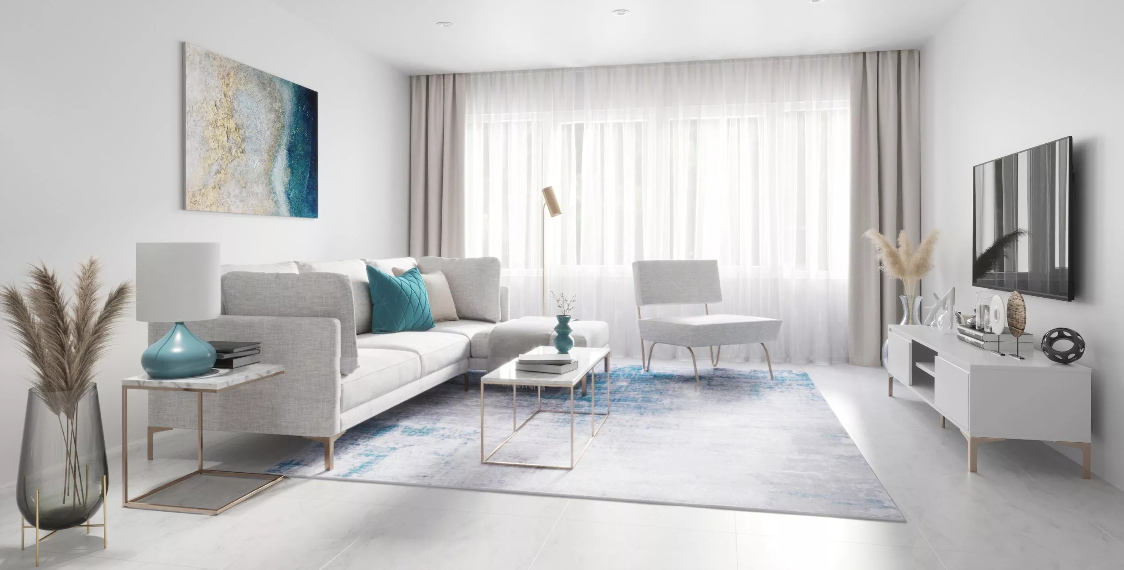
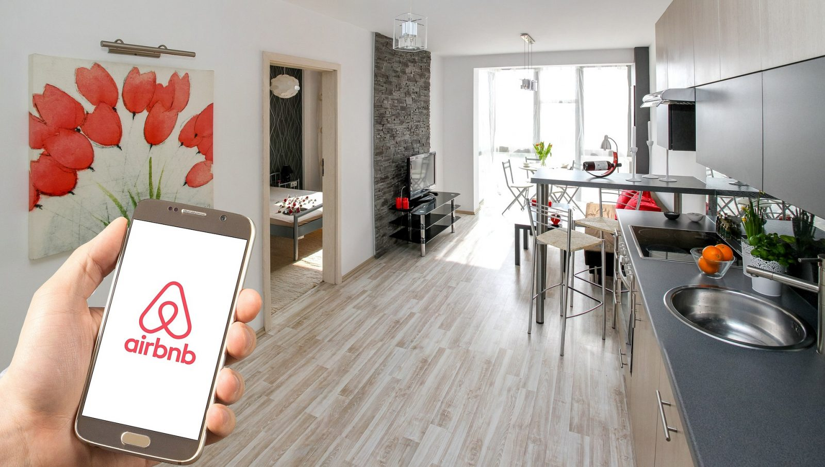



THE MARKET
MAKAN operates in a USD 14B furniture market, in the GCC only
$12B
1 Residential Furniture
2 Short-term Rentals
3 Staging
$2B
Total
$14B in GCC
4 Offices
Sources: Euromonitor, GM insights: Furniture market report, Exposervice: Index Saudi Brochure, Ibiworld: Furniture market reports
Notes:
With MAKAN, we want to address 4 market verticals:
- Residential furniture, for young professionals moving every year
- Short term rentals, for holiday home companies looking for solutions to furnish their properties
- Or Staging companies that use us to increase the value of a property
Another big market for us are offices: for enterprizes of all sizes looking for ready to move in offices
These markets amount to a 15B USD market in GCC

Slide 11


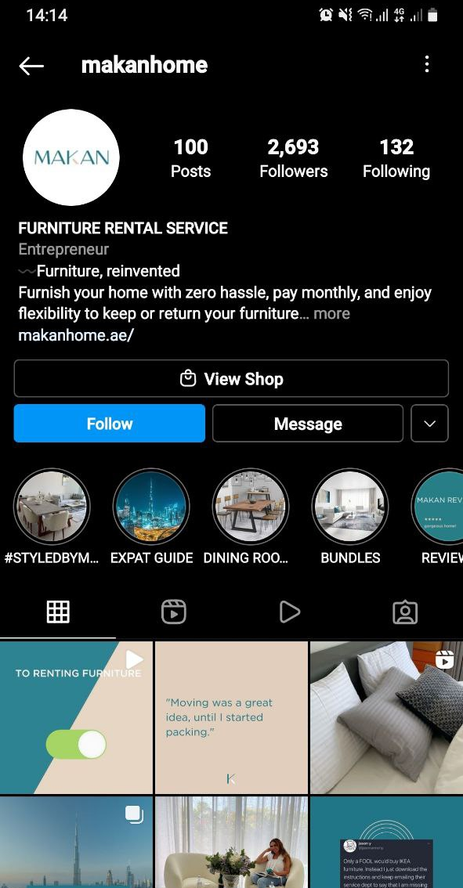




ACQUISITION MODEL
Growth is secured by diversified acquisition channels
DIGITAL CHANNELS (80%)
B2B PARTNERSHIPS (20%) - Focus of next 12 months
Strong brand image
Multi-channel presence:
FB, Insta, Google, Youtube, TikTok
(Soon: Bayut, Dubizzle & Property Finder)
Highly effective and optimized
ad engine (ROAS: x15)
Active partnerships with real estate, holiday home companies
B2B2C model (commission for agents) or, B2B (company as final client)
Key partnerships in the pipeline:
up to USD 1M ARR

Slide 12




TRACTION
60% MoM growth since the launch in July 2021
$0.9M ARR
MRR
(kUSD)
75K
3,000 items delivered
60%
Average Basket:
USD 2,000
LTV:CAC ratio
19:1
(forecast)
2021
2022
Notes:
We launched MAKAN 14 months ago and we are growing fast
- we achieved our USD 50K Monthly Recurring Revenue target last month
- had a strong 60% MOM growth on average
- and delivered more then 3000 items to customers

Slide 13




ROADMAP
MAKAN’s ambition is to become a reference furnishing player in MENA
2022
2023
2024
Focus on residential furniture
B2B2C partnerships development
‘Office’ furniture
MENA expansion
USD 1.1M ARR
(eoy)
USD 4M ARR
USD 10M ARR
Pipeline
Significant traction from strong branding effort, effective ad engine and preliminary partnerships
Focus on developing partnerships with real estate companies
(holiday homes and staging)
Expansion to new verticals
(e.g. offices) and new cities
Notes:
The first year we focused on residential furniture, and developed a strong market engine to conquer this market
Nex yeart we want to develpo our partnerships with real estate companies, holiday home and staging companies. We already have amazing partnerships in the pipeline
Later down the road we want to expand to office furniture, a 3B market in GCC

Slide 14











BENCHMARKS
The ambition is to bring to MENA a subscription model proven in other geographies
Adjacent industries
Furniture
Furniture
Furniture & electronics
Furniture & electronics
Electronics
Fashion
Founded in 2017
Founded in 2017
Founded in 2012
Founded in 2014
Founded in 2015
Founded in 2009
Equity / Debt Funding (USD)
46 M / 30 M
USD 45 M (total)
70 M / 160 M
USD 70 M (total)
150M / 220M
300 M / 200 M
Estimated ARR
~USD 25M
Not available
USD 20-25M
USD 15-20M
USD 200M
USD 160M
Stage
Series B
Series B
Series D
Series C
Series C
IPO
Valuation
~USD 250M
~USD 100-150M
~200M
~USD 150-200M
USD 1-1.5Bn
IPO Valuation
USD 1.7Bn

Slide 15










THE CORE TEAM
Youssef Sekkat
CO-FOUNDER
Othmane Saifaoui
CO-FOUNDER
Evgeniy Rohovets
TECH
Insaf Bennis
MARKETING
Reul Creado
OPERATIONS
Notes:
To execute this, we have a strong team, Youssef, myself and:
- Eugene, out Tech Guru
- Insaf of digital marketing expert
- Ruel, our operations hero

Slide 16

THE ASK
SEED ROUND: $1.5M
June 2021
Co-founders’ $100k
March 2022
Pre-seed round $754k
incl.
+ angel investors
B2B2C partnerships development
Back-end logistics,
Subscription management & customer experience
Procurement &
Customer Service
Notes:
After bootstrapping MAKAN for the first 6 months, we raised a preseed round earlier this year of 750K.
Today we are raising a seed round of 1.5M USD
we want to spend half of it in our tech, and the other half in our operations and sales and marketing

Slide 17
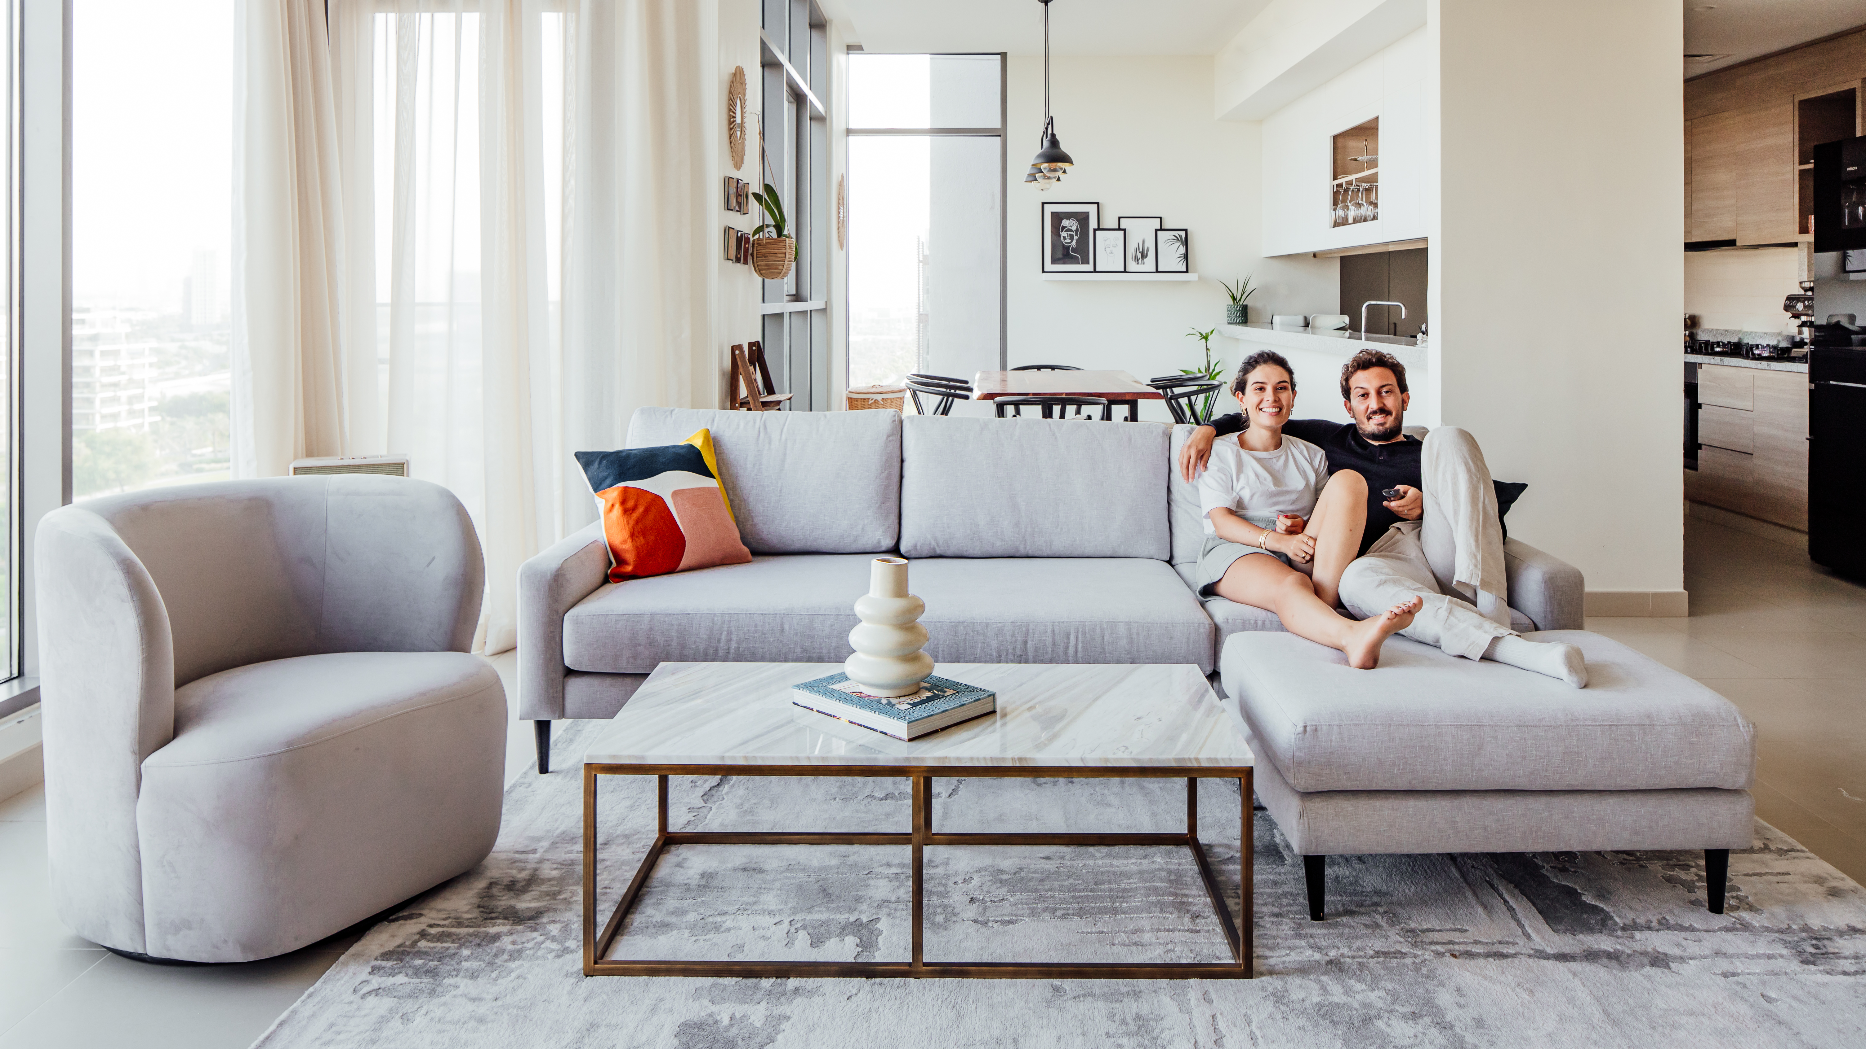




youssef.sekkat@makanhome.ae
+ 971 56 369 1189
www.makanhome.ae
@makanhome
Notes:
And today we invite you to join us, the reinvent the furnishing experience

