Slide 1
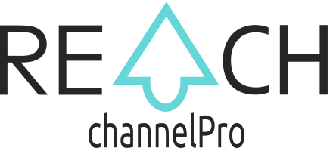
WE MAKE IT EASY FOR BRANDS TO CONNECT DIRECTLY WITH THEIR CHANNEL SALESPEOPLE
OCTOBER 2022

Slide 2
INTRODUCING CHANNELPRO
CHANNELPRO
Launched in 2021, ChannelPro is the developer of REACH, a channel sales force engagement platform.
Our easy-to-use SaaS platform helps brands and distributors educate, motivate and communicate with their indirect channel salespeople, to increase mindshare, product knowledge, time-to-market and overall channel sales performance.
REACH digitally transforms channel sales by connecting brands and distributors straight to their frontline salespeople.

Slide 3
WHAT IS THE CHANNEL SALES MODEL?
75%
.
of companies use the channel model to sell their products and services
BRAND
DISTRIBUTORS
Indirect sales channels allow big brands to scale globally and reach millions of customers.
x10,000
RESELLERS
x100,000
SALESPEOPLE

Slide 4
WHAT IS THE CHANNEL SALES MODEL?
.
Indirect salespeople are employed by the brand’s partners or retailers and sell the brand’s products.
BRAND
DISTRIBUTORS
Brands are not
connected directly
to their channel salespeople
x10,000
RESELLERS
x100,000
SALES PERSONS

Slide 5
WHAT ARE THE CHALLENGES?
Relying on third parties to sell your product has inefficiencies.
SALESPEOPLE LACK PRODUCT KNOWLEDGE
SALESPEOPLE ARE OFTEN GIVEN NO INCENTIVES
BRANDS LACK FRONTLINE SALES DATA
Brands have no manageable way to educate their channel salespeople at scale, or grow sales force mindshare.
It's difficult for brands to incentivise indirect sales people, or influence their sales results.
Brands have no access to data or insights from their frontliners to support decision-making.

Slide 6
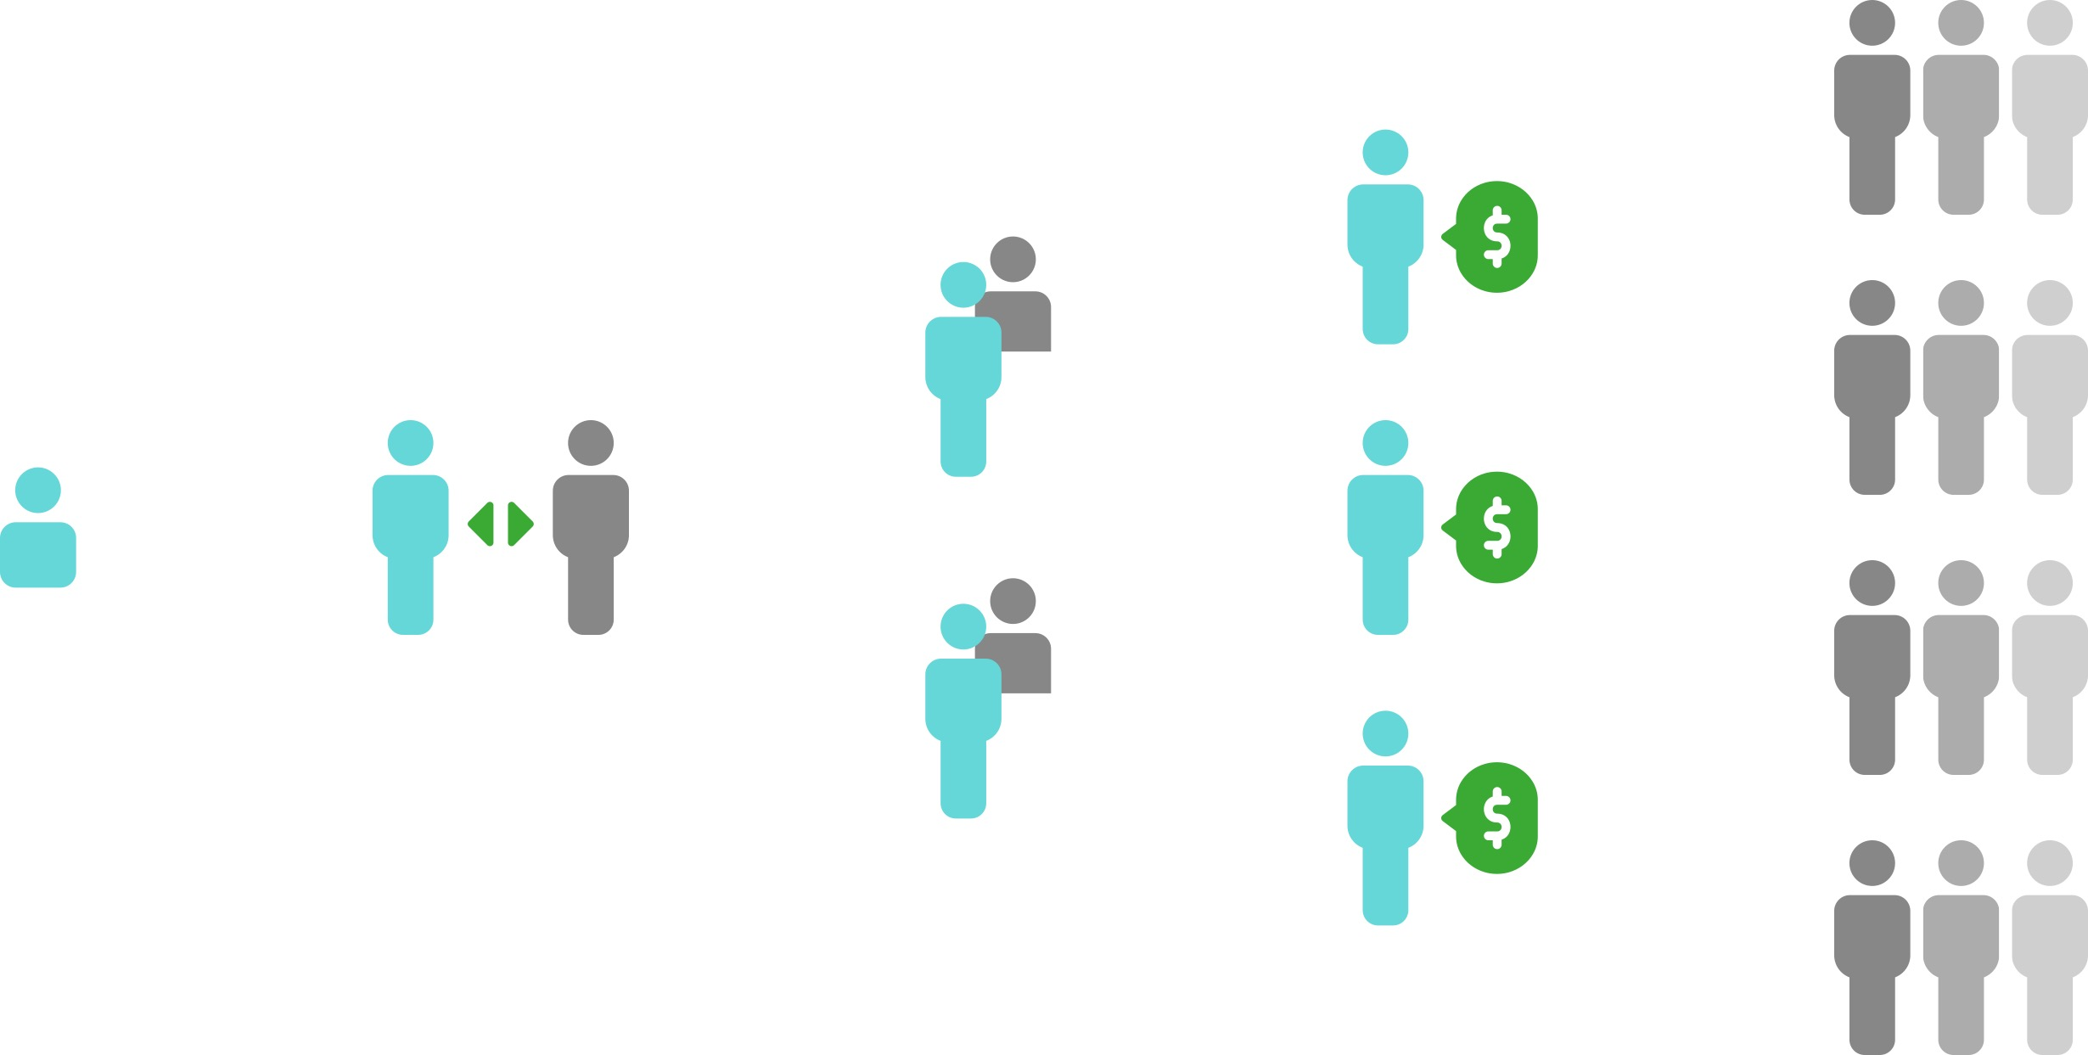
THE PRODUCT SOLUTION
We solve all these problems by connecting brands directly to their indirect salespeople.
BRAND
DISTRIBUTOR
RESELLER
SALES
PERSON
CUSTOMER

Slide 7
REACH PLATFORM
Our platform connects brands and distributors with their indirect sales force, so they can…
COMMUNICATE
INCENTIVIZE
COLLECT DATA
Brands can use Reach to communicate cost effectively with their frontline sales force in an instant.
Our platform makes it easy for brands to run automated incentive programs to motivate their sales force and drive sales.
Brands get real-time sales data and insights about channel sales force performance to support better decision-making.

Slide 8
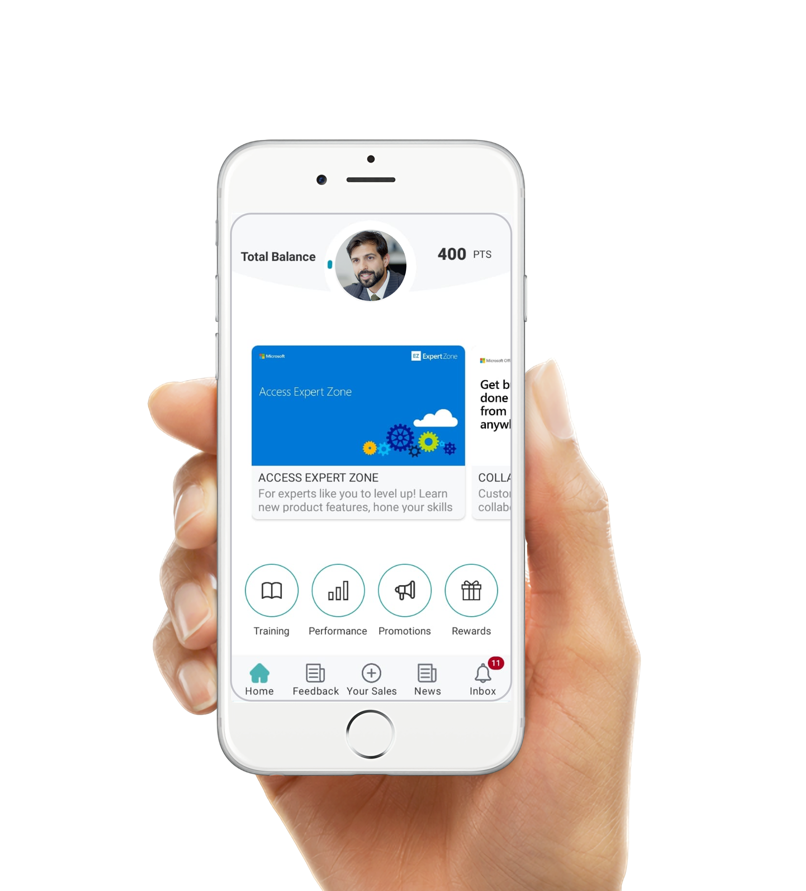
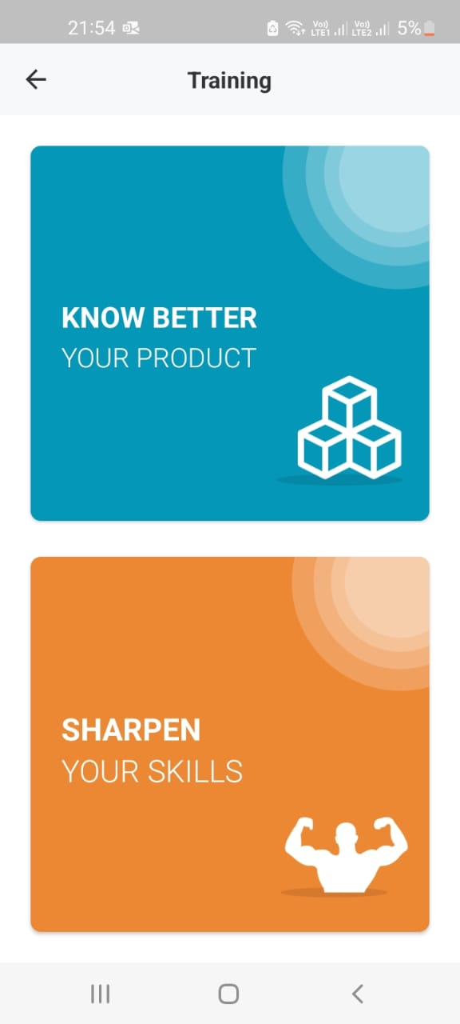
REACH PLATFORM
CHANNEL SALESPEOPLE
gain access via the mobile Reach app to:
Product knowledge & training
Sales incentives & rewards
Real-time updates

Slide 9
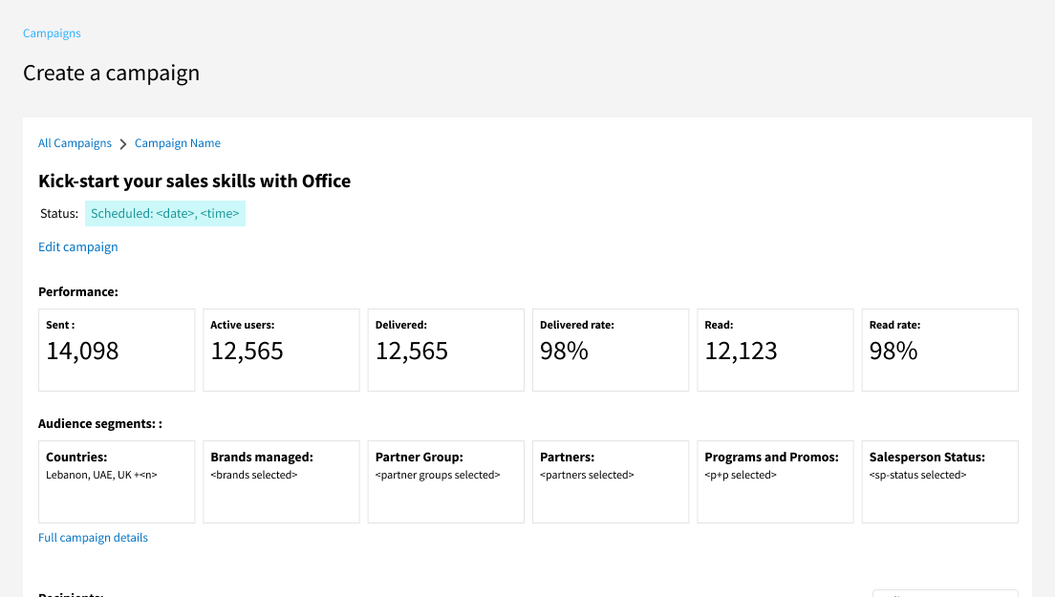
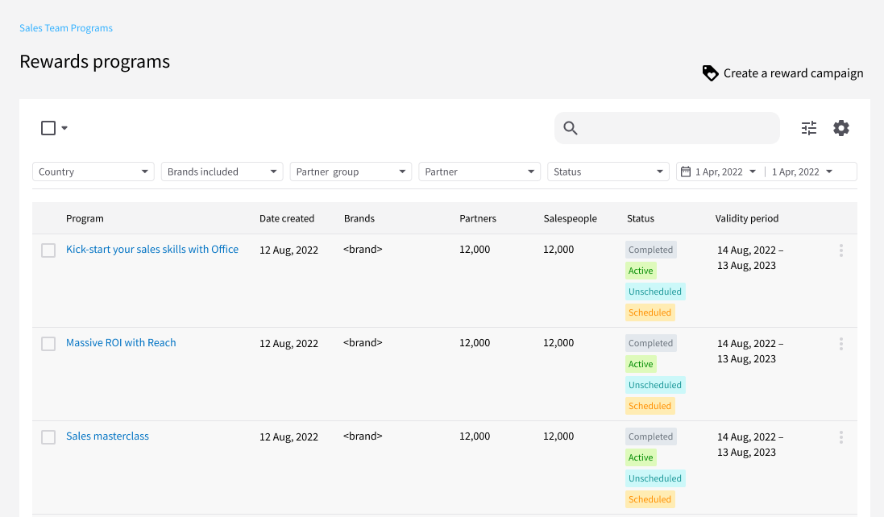
REACH PLATFORM
BRANDS
use the Reach webapp to:
Communicate directly with their frontline channel salespeople
Segment and tailor sales programs for different groups of salespeople
Grow sales force ‘mindshare’ via regular communications
Get real-time sales data insights to inform better decision-making

Slide 10
SUBSCRIPTION BASED SaaS MODEL
Our core revenue model is SaaS subscription, with modular add-ons, plus the option of enterprise services
OUR MONTHLY SUBSCRIPTION STARTS AT
OUR SECONDARY REVENUE MODELS INCLUDE:
$1,500
Augmented features
Data products
Enterprise services
Inclusive of 100 users
Volume price breaks available for above 100 users
WHO IS OUR IDEAL CUSTOMER?
Our ideal customers are information and communications technology vendors, who are quick to embrace new digital technology, fast to implement and have sophisticated channel sales ecosystems that can fully leverage the Reach platform

Slide 11
MARKET & COMPETITIVE LANDSCAPE
Channel management automation & services
$1.75bn
2025 MENA
SAM
Brands spend billions of dollars per year on channel marketing software
60% of companies in the U.S. haven’t yet automated their channel marketing
$35bn
$525m
2025 UAE
SAM
2025 GLOBAL
SAM
Sources: Calculated based on data sourced from Forrester 2021

Slide 12
TRAJECTORY MILESTONES
LAUNCHED 2021
Sep 2022
Recognized by Forrester in its Channel Software Tech Stack 2021.
Aug 2022
$5k
MRR
May 2022
10
New countries onboarded
Jan 2022
300
Channel salespeople are now using the REACH app
3
The 2 leading IT distributors in Africa added
FUNDING
Graduated as a top startup from the Founder institute
Funding from Loyal VC
$150k funding from Flat6Labs
6
New customers (large IT distributors)

Slide 13
REACH PRODUCT ROADMAP
PRODUCT DEVELOPMENT
2022 – 2025
2022
2023
2024 - 2025
β
V1
+ versions
V3, V4
BETA
‘CHAMPION’
‘HERO’ & ‘FUTURE’
Platform for channel sales
incentive management
Cloud app for channel sales
force engagement (incentives, education, communications)
AI app for channel sales
force engagement, and market intelligence

Slide 14
REACH PRODUCT ROADMAP
PRODUCT DEVELOPMENT
The next 12 months
2023
Create an improved, self-service version
Augment the product for power-users
Expanded training module
Advanced communications features
Enhanced data insights dashboard
V1
+ versions
‘CHAMPION’
Cloud app for channel sales
force engagement

Slide 15
GO TO MARKET STRATEGY
2022 – 2026
How our sales and marketing will develop over the next 36 months
2022
2023
2024 - 2025
DIRECT SALES
MARKETING ACQUISITION
DIRECT, INDIRECT & ECOMMERCE
Sales acquisition via direct sales, networking & referrals. Deep dives with customers on needs and user experience.
Sales acquisition + marketing acquisition via campaigns, creating a predictable sales engine
A model that allows direct & indirect sales, self-service ecommerce, plus enterprise options

Slide 16
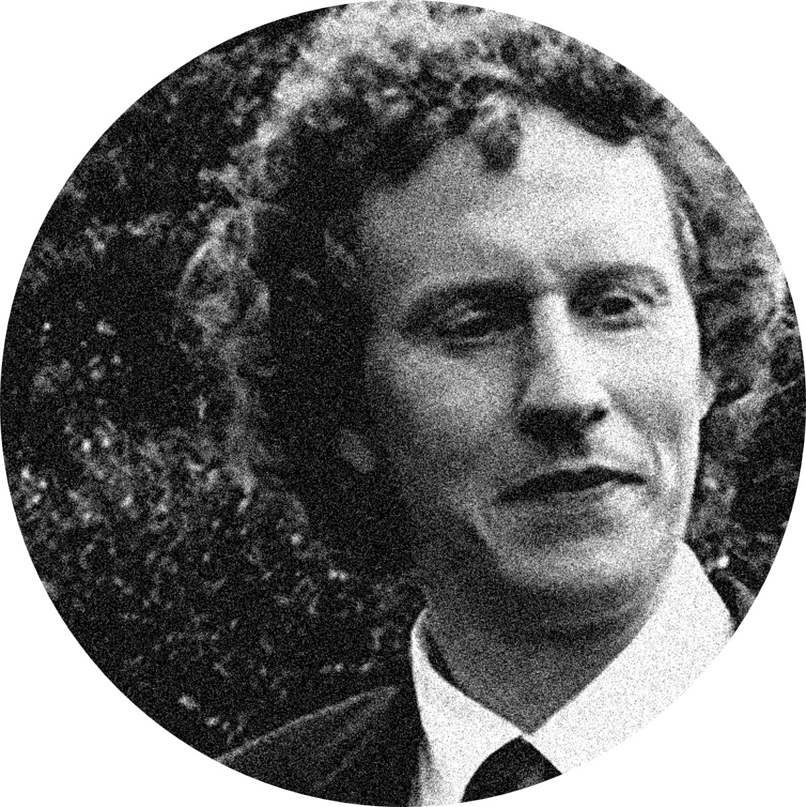
THE TEAM
75 years
of combined experience in Channel Management
Elias B. Ghosn
Carrington Malin
Craig Willers
Founder
Marketing
Product strategy
20+ years in IT industry
Acer, Fujitsu, Microsoft
EMEA channel management
25+ years tech marketing
Cisco, IBM, Intel, Lenovo*
360° marketing skills
Product visionary
Beneple, EdStatica, Tallarium
CX, UX, data-driven design
Georges Rattel
Rami Miari
Technology
Development
Tech strategy
ERP, CRM, networks
Advocate of clean code
Tech polymath
PHP Laravel, JS, React
Analytics platforms

Slide 17
THE ASK
$450k
USE OF FUNDING
investment required
35%
Product development
in order to:
Enhance the Reach platform
Build a predictable revenue engine
Drive sales growth and expansion
5%
Others
25%
Team
35%
Sales & Marketing

Slide 18
INVESTING IN CHANNELPRO
SUMMARY
A STRONG FOUNDING TEAM
A CLOUD NATIVE PLATFORM
A FAST GROWING MARKET SEGMENT
In depth knowledge of both the market segment and actual customers.
.
Scalable, extendable, meaning faster time-to-market for new features.
A long ignored gap, but now growing fast as brands accelerate digitization.
REAL MARKET TRACTION
EXCELLENT GROWTH POTENTIAL
INVEST IN
Several multi-billion dollar companies already rely on the Reach platform.
We’re solving a global problem, so there is a big global market opportunity.

Slide 19
TRANSFORMING YOUR CHANNEL SALES
www.channelpro.co
ELIAS BOU GHOSN
Founder & CEO
050 645 3543
elias@channelpro.co

