Slide 1


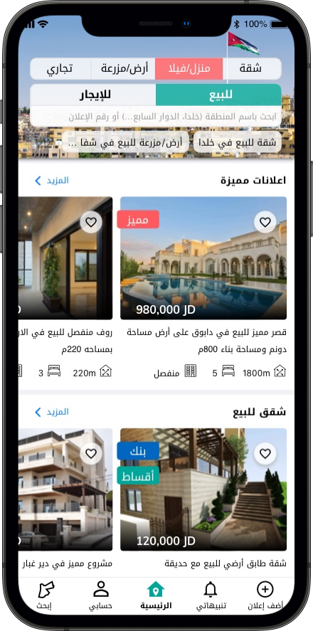
Sell faster. Buy with confidence.
Ahmed Nawasrah
Co-Founder - CEO
Ahmed.Nawasrah@khareta.com
+962 (0) 7 9821 6171
Sep 2022
Notes:
Hello I'm Ahmed Nawasrah, a co-founder of Khareta. Khareta is a real estate marketplace that helps people make better investment decisions.

Slide 2



The challenge & opportunity
Problem
210 days⁽¹⁾ _{(median)}
To sell an apartment in Jordan
25 days⁽²⁾ _{(median)}
To sell a house in the US
Why?
Lack of transparency in real estate markets
Solution
A data-driven real estate marketplace
Khareta.com listings data from 2019-2020 statistics
Zillow.com days on market
Notes:
It takes 25 days to sell a house in the US. But it takes 210 days to sell an apartment in Jordan.
There are multiple reasons for this huge inefficiency, but the main one is the lack of transparency in the real estate market.

Slide 3

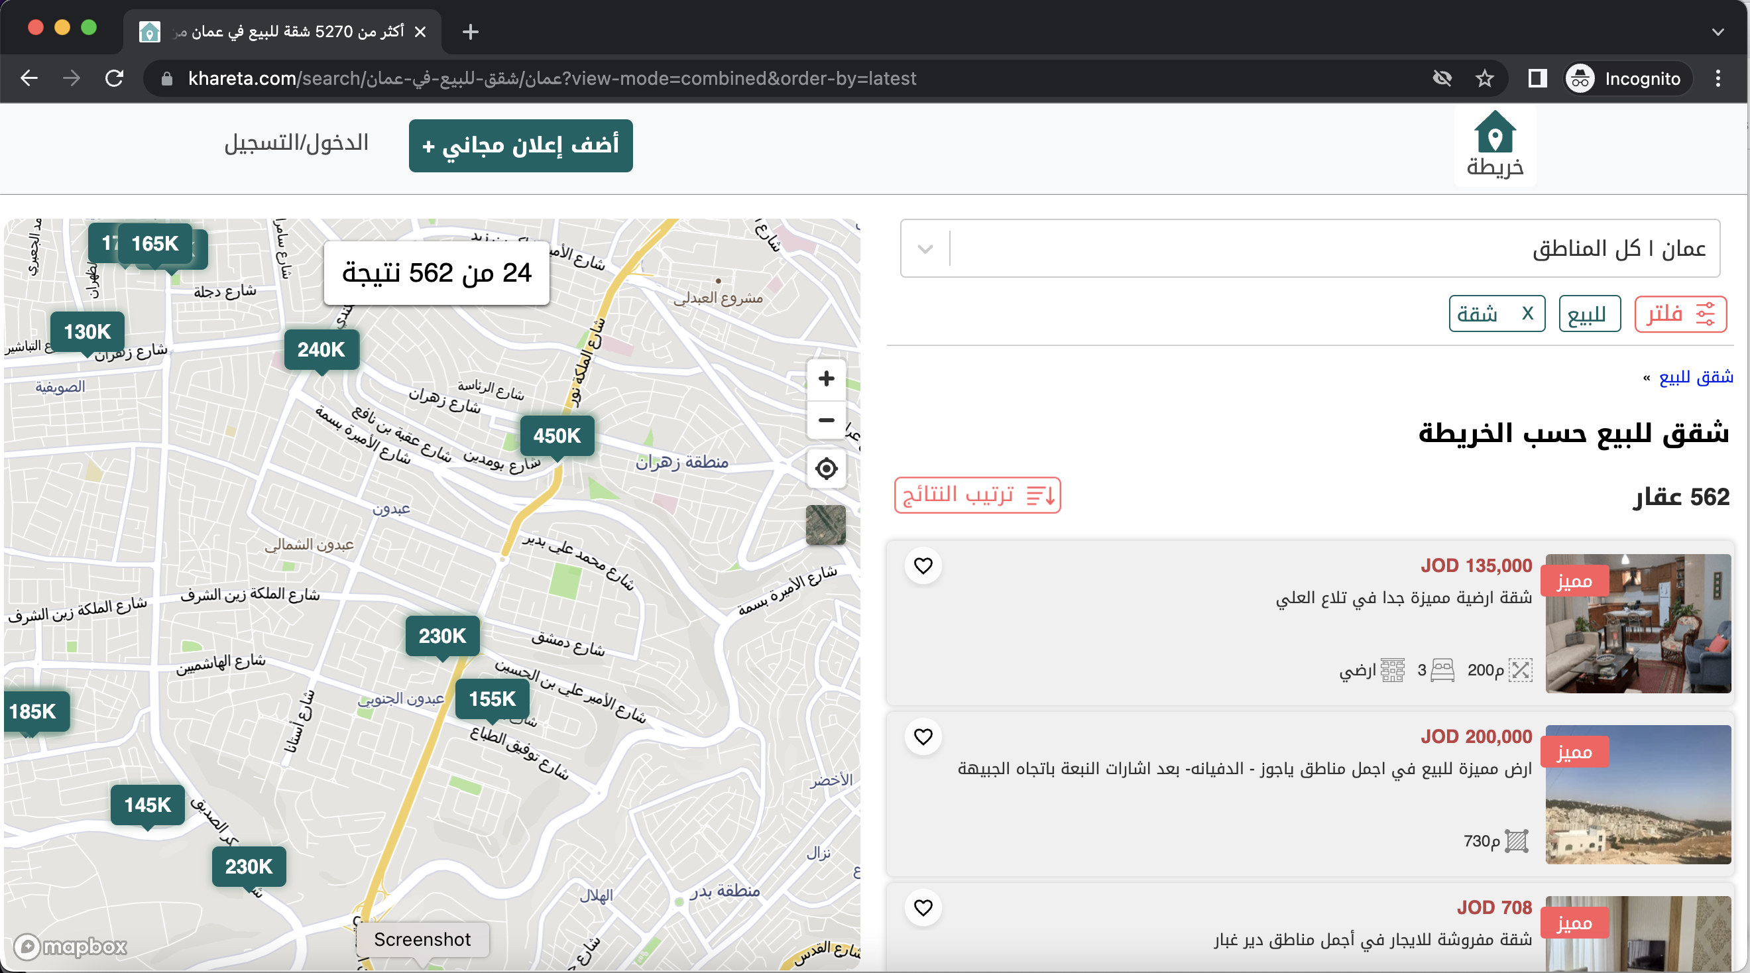
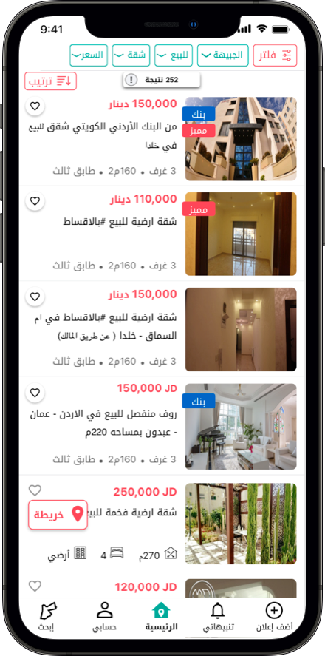

Khareta helps sellers sell fast and buyers buy with confidence
We collect millions of data points to provide insights on our seamless web and mobile app
Notes:
And here comes Khareta, a data-driven real estate marketplace that helps sellers to sell fast, and buyers to buy with confidence. We aggregate and analyze a lot of data from various sources to provide insights on the real estate market and present them on a seamless web and mobile app experience.

Slide 4
Real estate data collection, processing and presentation are our differentiators
REAL ESTATE PROPERTIES
PROCESS & ANALYZE
REAL ESTATE DATA
Individual Owners
Public Data
- Department of Land
- City Municipalities
RE Developers
3rd Party Data
- Bank mortgage data
- Points of interest
RE Brokers
In-house Data
- Listings
- User behavior
Bank Properties
Notes:
Every month we collect and receive over a thousand listings directly from owners, developers, brokers and even bank properties. And our data team actively collects millions of data points from public sources, such as the Department of Land and city municipalities. We collect 3rd party data and user behavior on our marketplace.

Slide 5
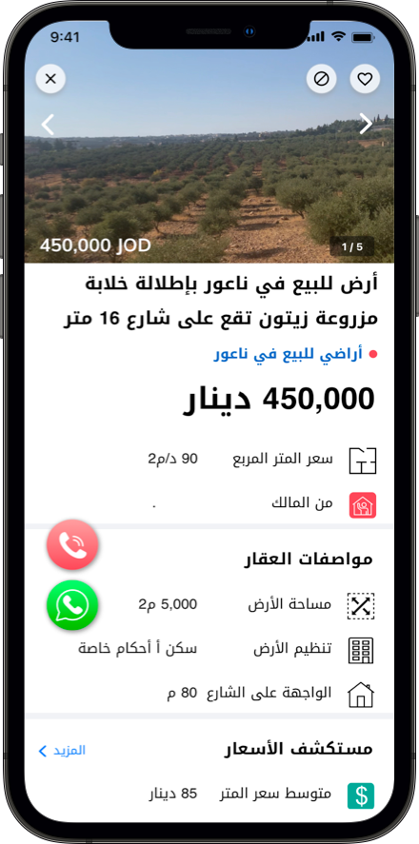
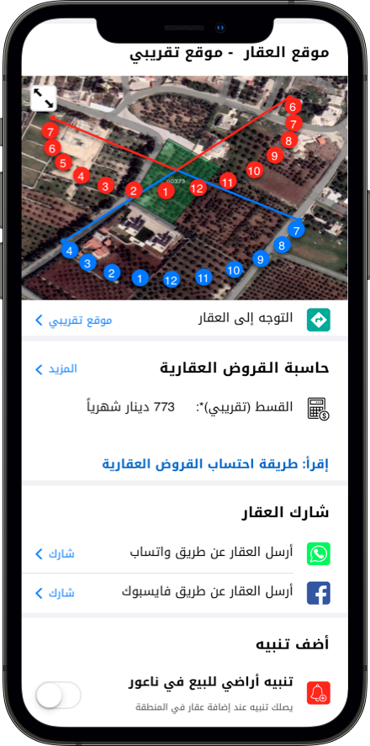
Data visibility to make faster investment decisions
Integration with the land department
Full visibility of listing details
Inquire and apply for a mortgage
Price/m² in the neighborhood
Notifications about new properties
Notes:
Our data capabilities are a major differentiator for Khareta, as well as the way we present the data and insights to our users. Our technology team has built a best-in-class web and mobile app experience. We provide a wealth of information, beyond any other marketplace. We show the user details of the property value, and we are working to integrate with the department of land to show zoning details. We even show users how the sun rises and sets on the property. Again, we are on a mission to help users make informed decisions.

Slide 6
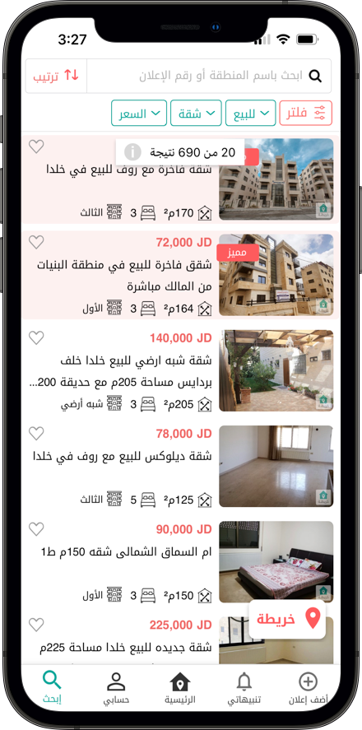
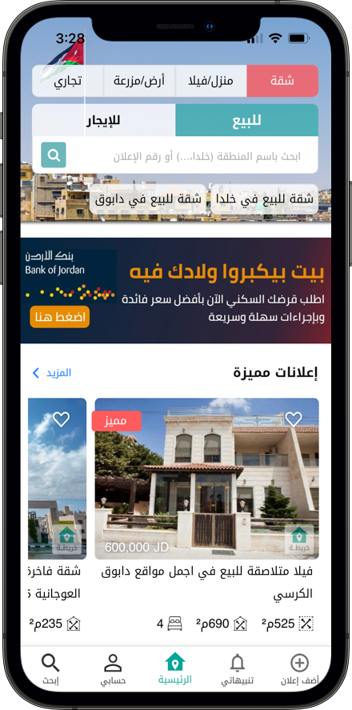
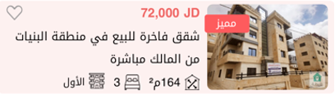

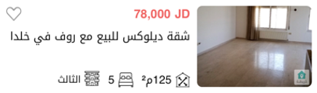
Pricing: free to list, pay to boost
Boosted ads $42/month
Premium ads $565/month
Lead Generation
2% of property value
Free to list
Notes:
Our pricing is straight forward. It is free for anyone to list on Khareta. Users can choose to pay a fee to boost their ads. And recently, we introduced a lead generation fee of 2% on transactions that are facilitated and closed by our staff.

Slide 7
Great traction
185,000+
Registered Users
35,000+
Verified Listings
50% of listings are directly from owners
Notes:
While many others have attempted to do real estate marketplaces, few have succeeded, because there is much more to it than just listing properties. We started in 2019, and we have great traction, with over 185k registered users, and 35,000 verified listings. 50% of listings on Khareta are directly from owners.

Slide 8
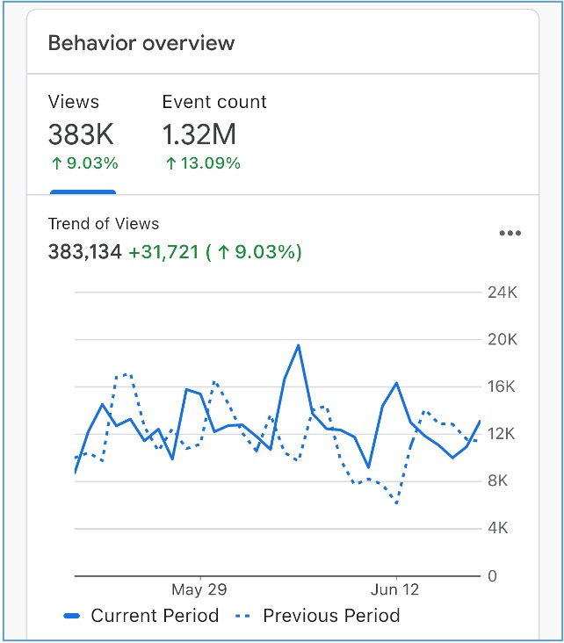
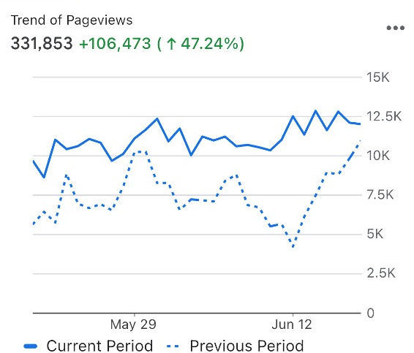
High engagement on app and website
App
380,000+
Monthly Listing Views
Website
330,000+
Monthly Listing Views
Notes:
Every month, we have over 380k listing views on our app, and 330k views on the website.

Slide 9
Khareta delivers great value to its users
2021 Numbers
$7.1B⁽²⁾
$2.5 Billion⁽¹⁾
Value of properties listed on Khareta website and app
Real estate transactions in Jordan
$593M⁽³⁾
Value or properties listed and sold on Khareta
2,882⁽³⁾
Number of sold and rented properties on khareta
8.4%
(1) Calculated as the sum of the declared prices on property listings
(2) DLS Data – Jordan
(3) Calculated as the sum (count) of the declared prices on properties that were listed and removed in the same year (2021)
Notes:
But the traction we are most proud of, is the value we deliver to our users.
In 2021, the value of properties listed on Khareta exceeded $2.5B. And we helped facilitate 2880 transactions, worth nearly $600M. This is 8.4% of all real estate transactions in Jordan.
We are confident that with the data visibility we provide, we can drive the days-on-market significantly down, which not only helps the real estate market but the overall economy.

Slide 10
$126K total revenue
50% increase in revenue in H1 2022 compared to last year
$96K
$30K
$19K
Notes:
We started monetizing in 2021, and we generated $126k revenue. In the first half of this year, we saw a 50% growth compared to the same period of last year.

Slide 11
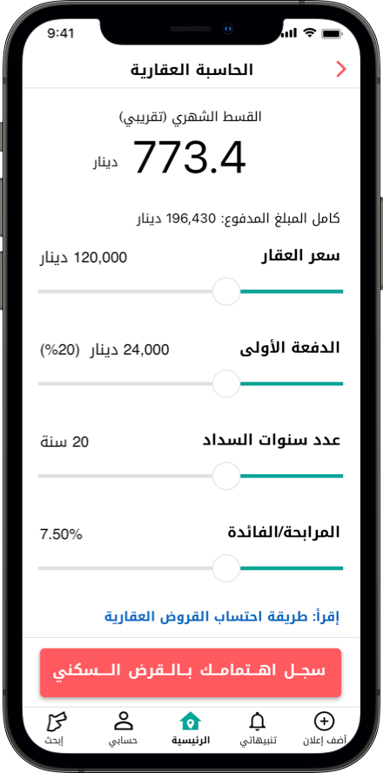
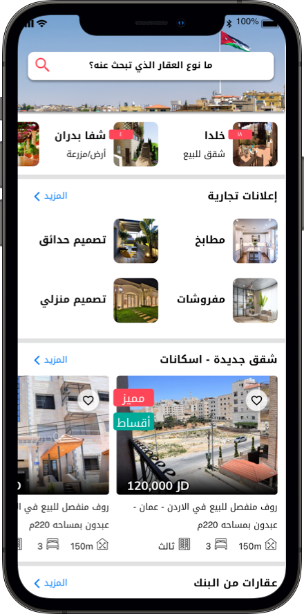
Road map: more features, more regions
Offer mortgage lead generation
Super-app of all real estate businesses
Notes:
But we still have more to offer. We are working with banks to provide mortgage estimates and leads on our platform. We are also building a super-app for all real estate related businesses, beyond just properties.

Slide 12
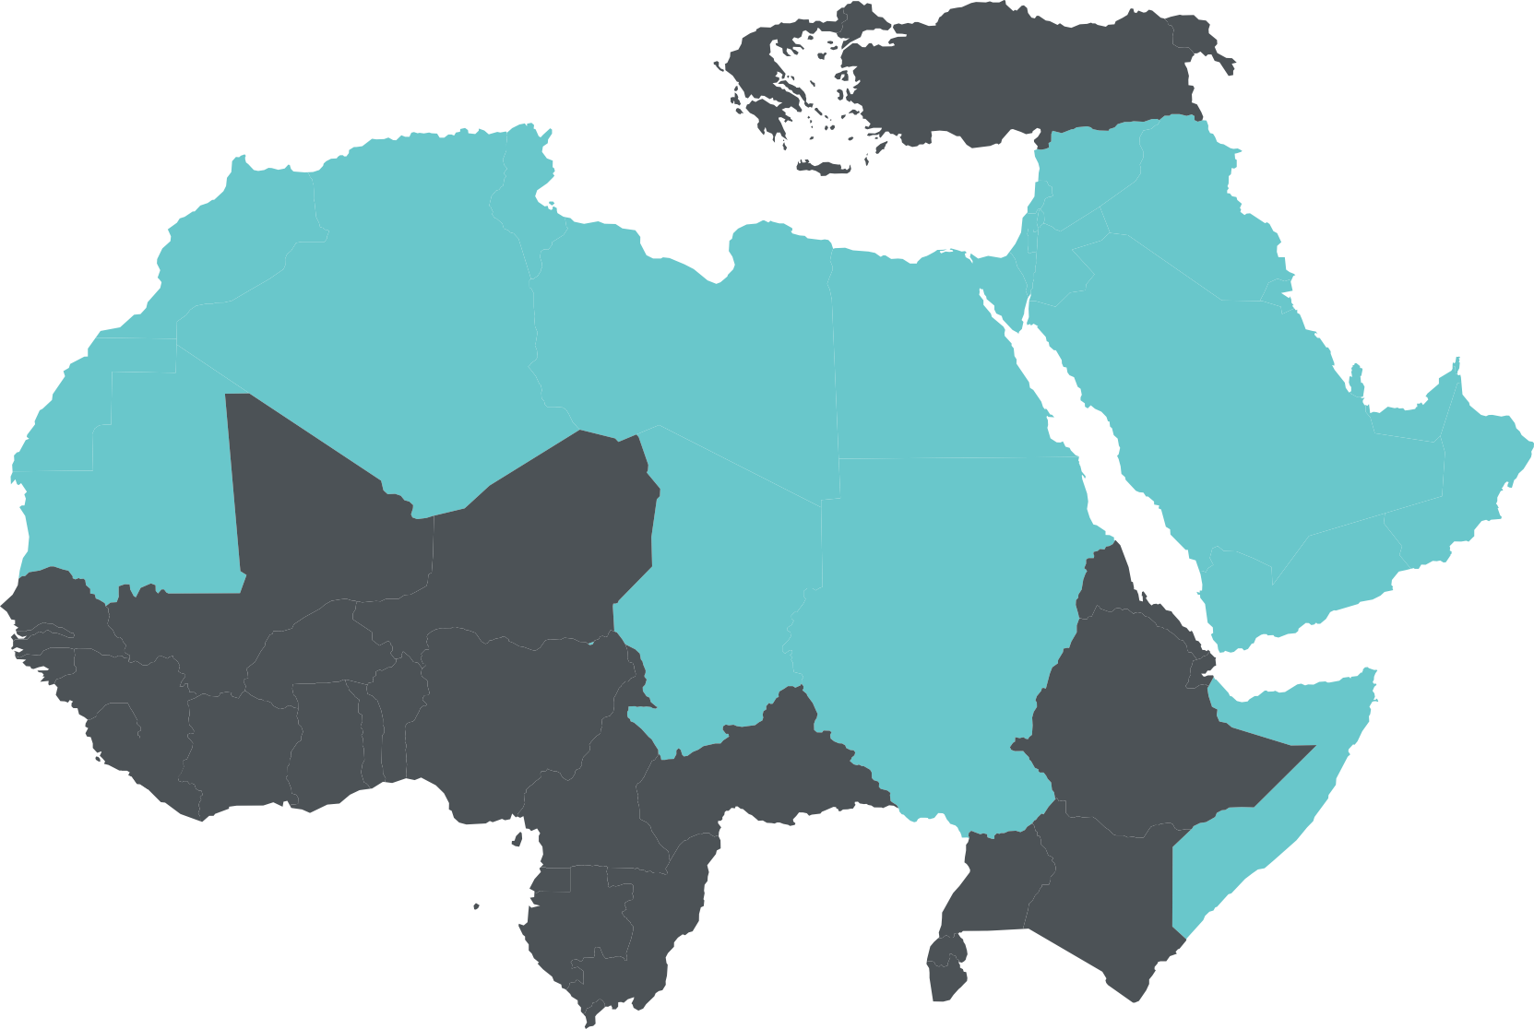
Regional real estate markets
Advertising potential ($2.6B+)
Jordan
$7.1B
Real estate market
$100M
Advertising potential
Egypt
$46.4B
Real estate market
$650M
Advertising potential
Saudi Arabia
$140.3B
Real estate market
$1.9B
Advertising potential
Real estate market size is based on 2019 data
Advertising spend is based on 1.4% ratio of advertising spend to total market (US data )
Notes:
We started in Jordan. But the challenges in the Jordanian market are not different from the region. We plan to go after Saudi and Egypt and provide the same great experience to more users.

Slide 13
Use of funds
Khareta is seeking a total of $2M
$0.5M
Marketing & Product Development
$1.5M
Geographic Expansion
Notes:
To do this, we are looking to raise $2 million that will go towards developing new features and to finance our geographic expansion.

Slide 14



Founding team
Ahmed Nawasrah Co-Founder
MBA, Major in Entrepreneurship, Boston University
Chief Commercial Officer, Mawdoo3.com, Jordan
Corporate Strategic Planning Manager, Emerson Electric, UAE
Nedal Nawasrah Co-Founder
General Manager
PhD, Web Engineering GUI, Computer Science
Islam Alsarabi Co-Founder
PhD, Business Leadership, Franklin Pierce University
Innovation Leadership, MIT
Senior Continuous Improvement, Philips, Massachusetts, USA
Notes:
The founding team of Khareta are myself, I have an MBA from Boston University,
Nedal, has a PHD in user interface, super helpful in building the mobile apps,
And Islam is a certified innovation leader from MIT and has a PHD in business leadership.

Slide 15
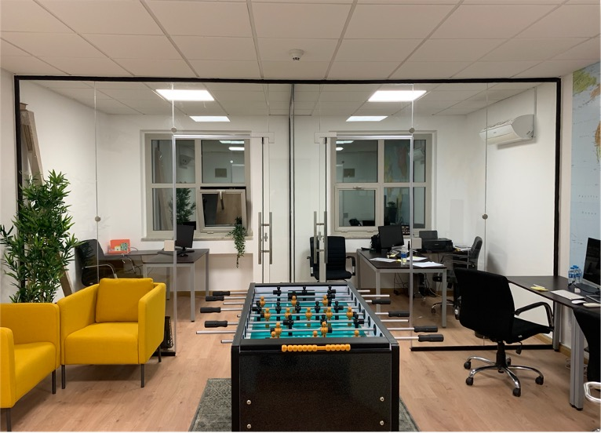
Thank You
Notes:
We invite you to join us on our journey to a frictionless real estate marketplace that allows sellers to sell fast and buyers to buy with confidence. Thank you.

