Slide 1
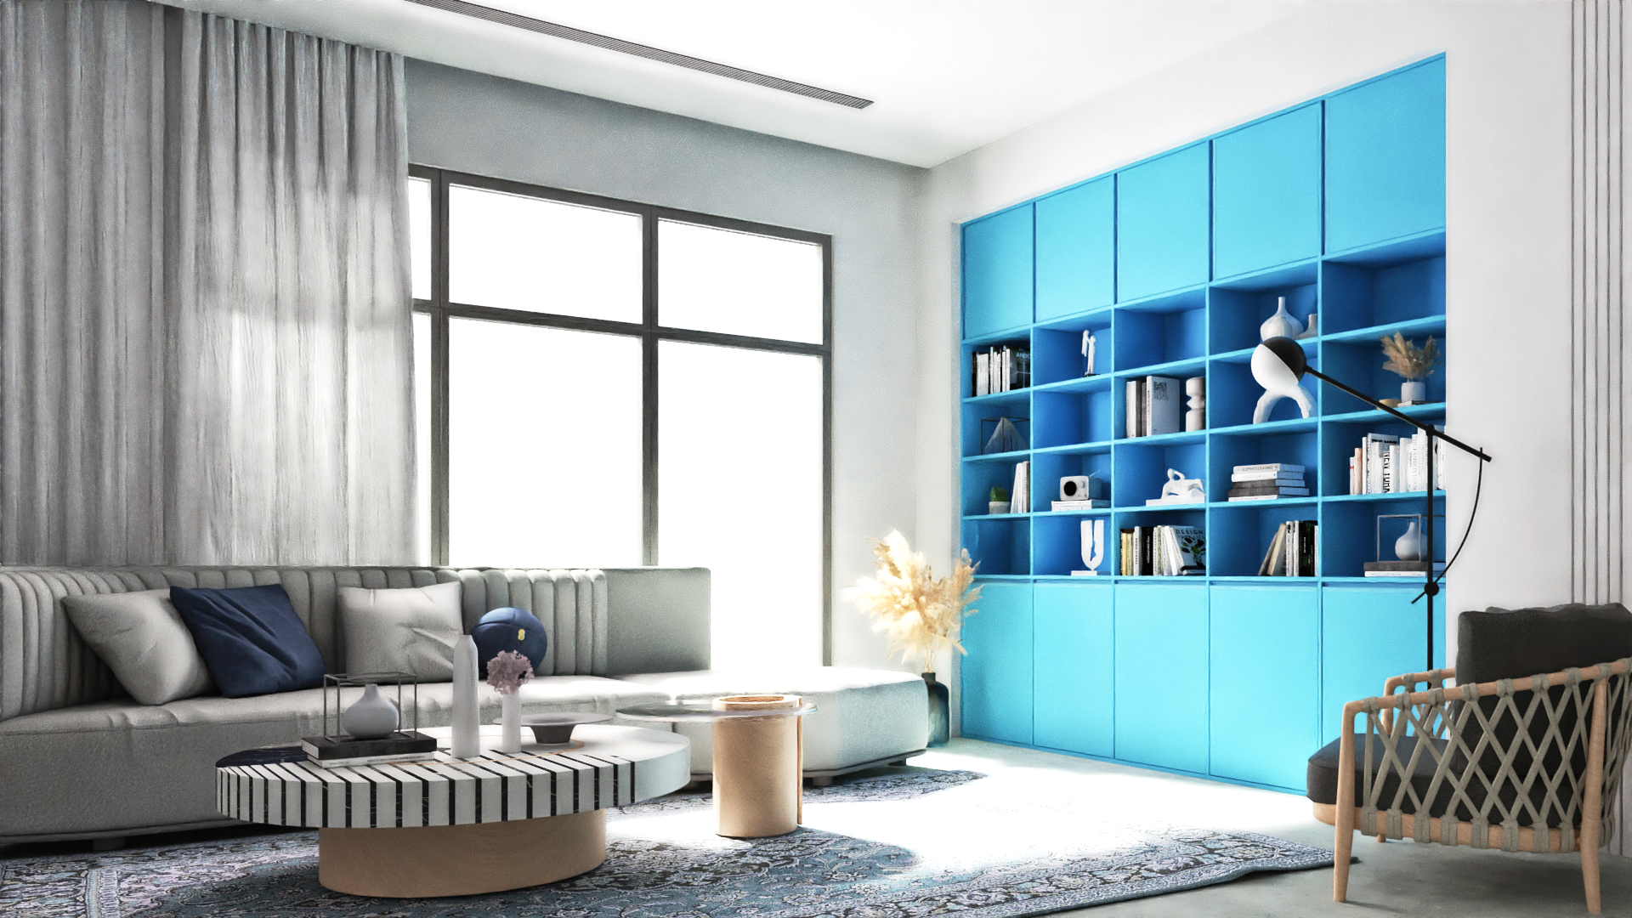
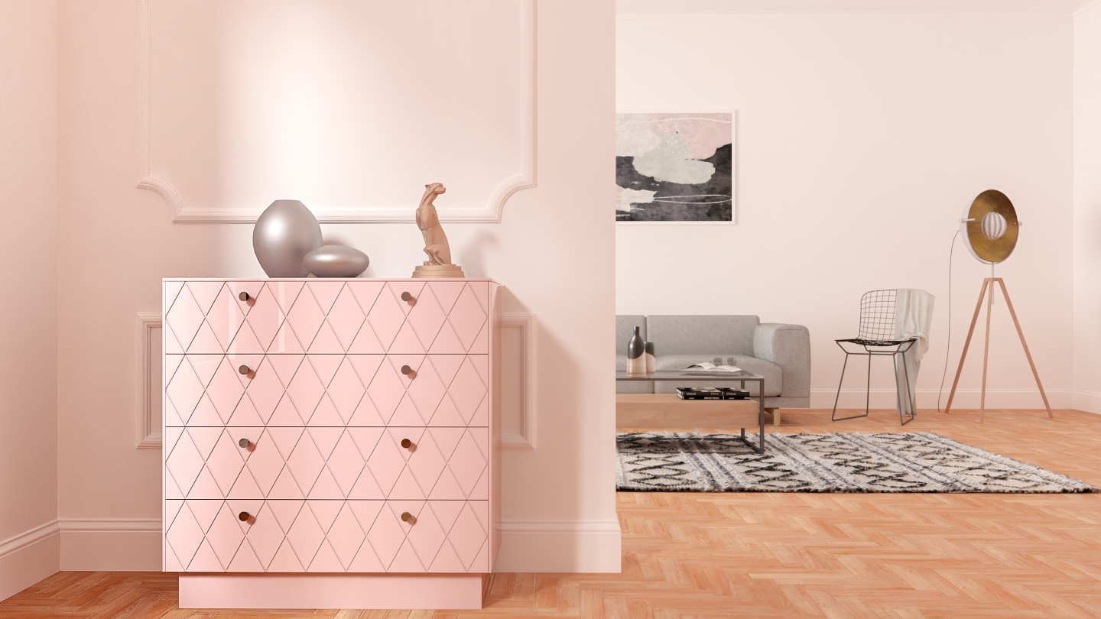
Tailor-made for everyone

Slide 2
1.
2.

Slide 3
Problem
On average, furniture shoppers take 3 to 5 weeks to find “the right” product.
Furniture-shopping experience is very outdated.
Visualizing the right fit in their own home is impossible.
Furniture customization is never “truly custom”.
3.

Slide 4
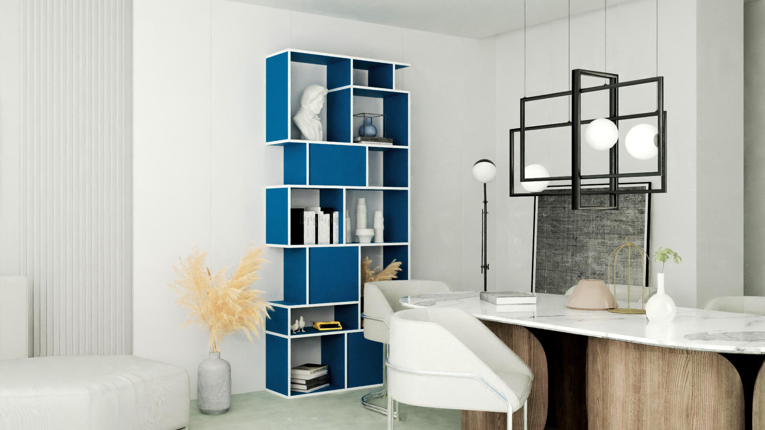
Next-generation furniture company.
Online-first operating as Direct-to-Consumer.
Tech-driven online customization tool
Seamless design-to manufacturing process
4.

Slide 5
Traditional Mass-Production
5.

Slide 6
Traditional Mass-Production
5.

Slide 7
Traditional Mass-Production
5.

Slide 8
Traditional Mass-Production
5.

Slide 9
Traditional Mass-Production
5.

Slide 10
Traditional Mass-Production
5.

Slide 11
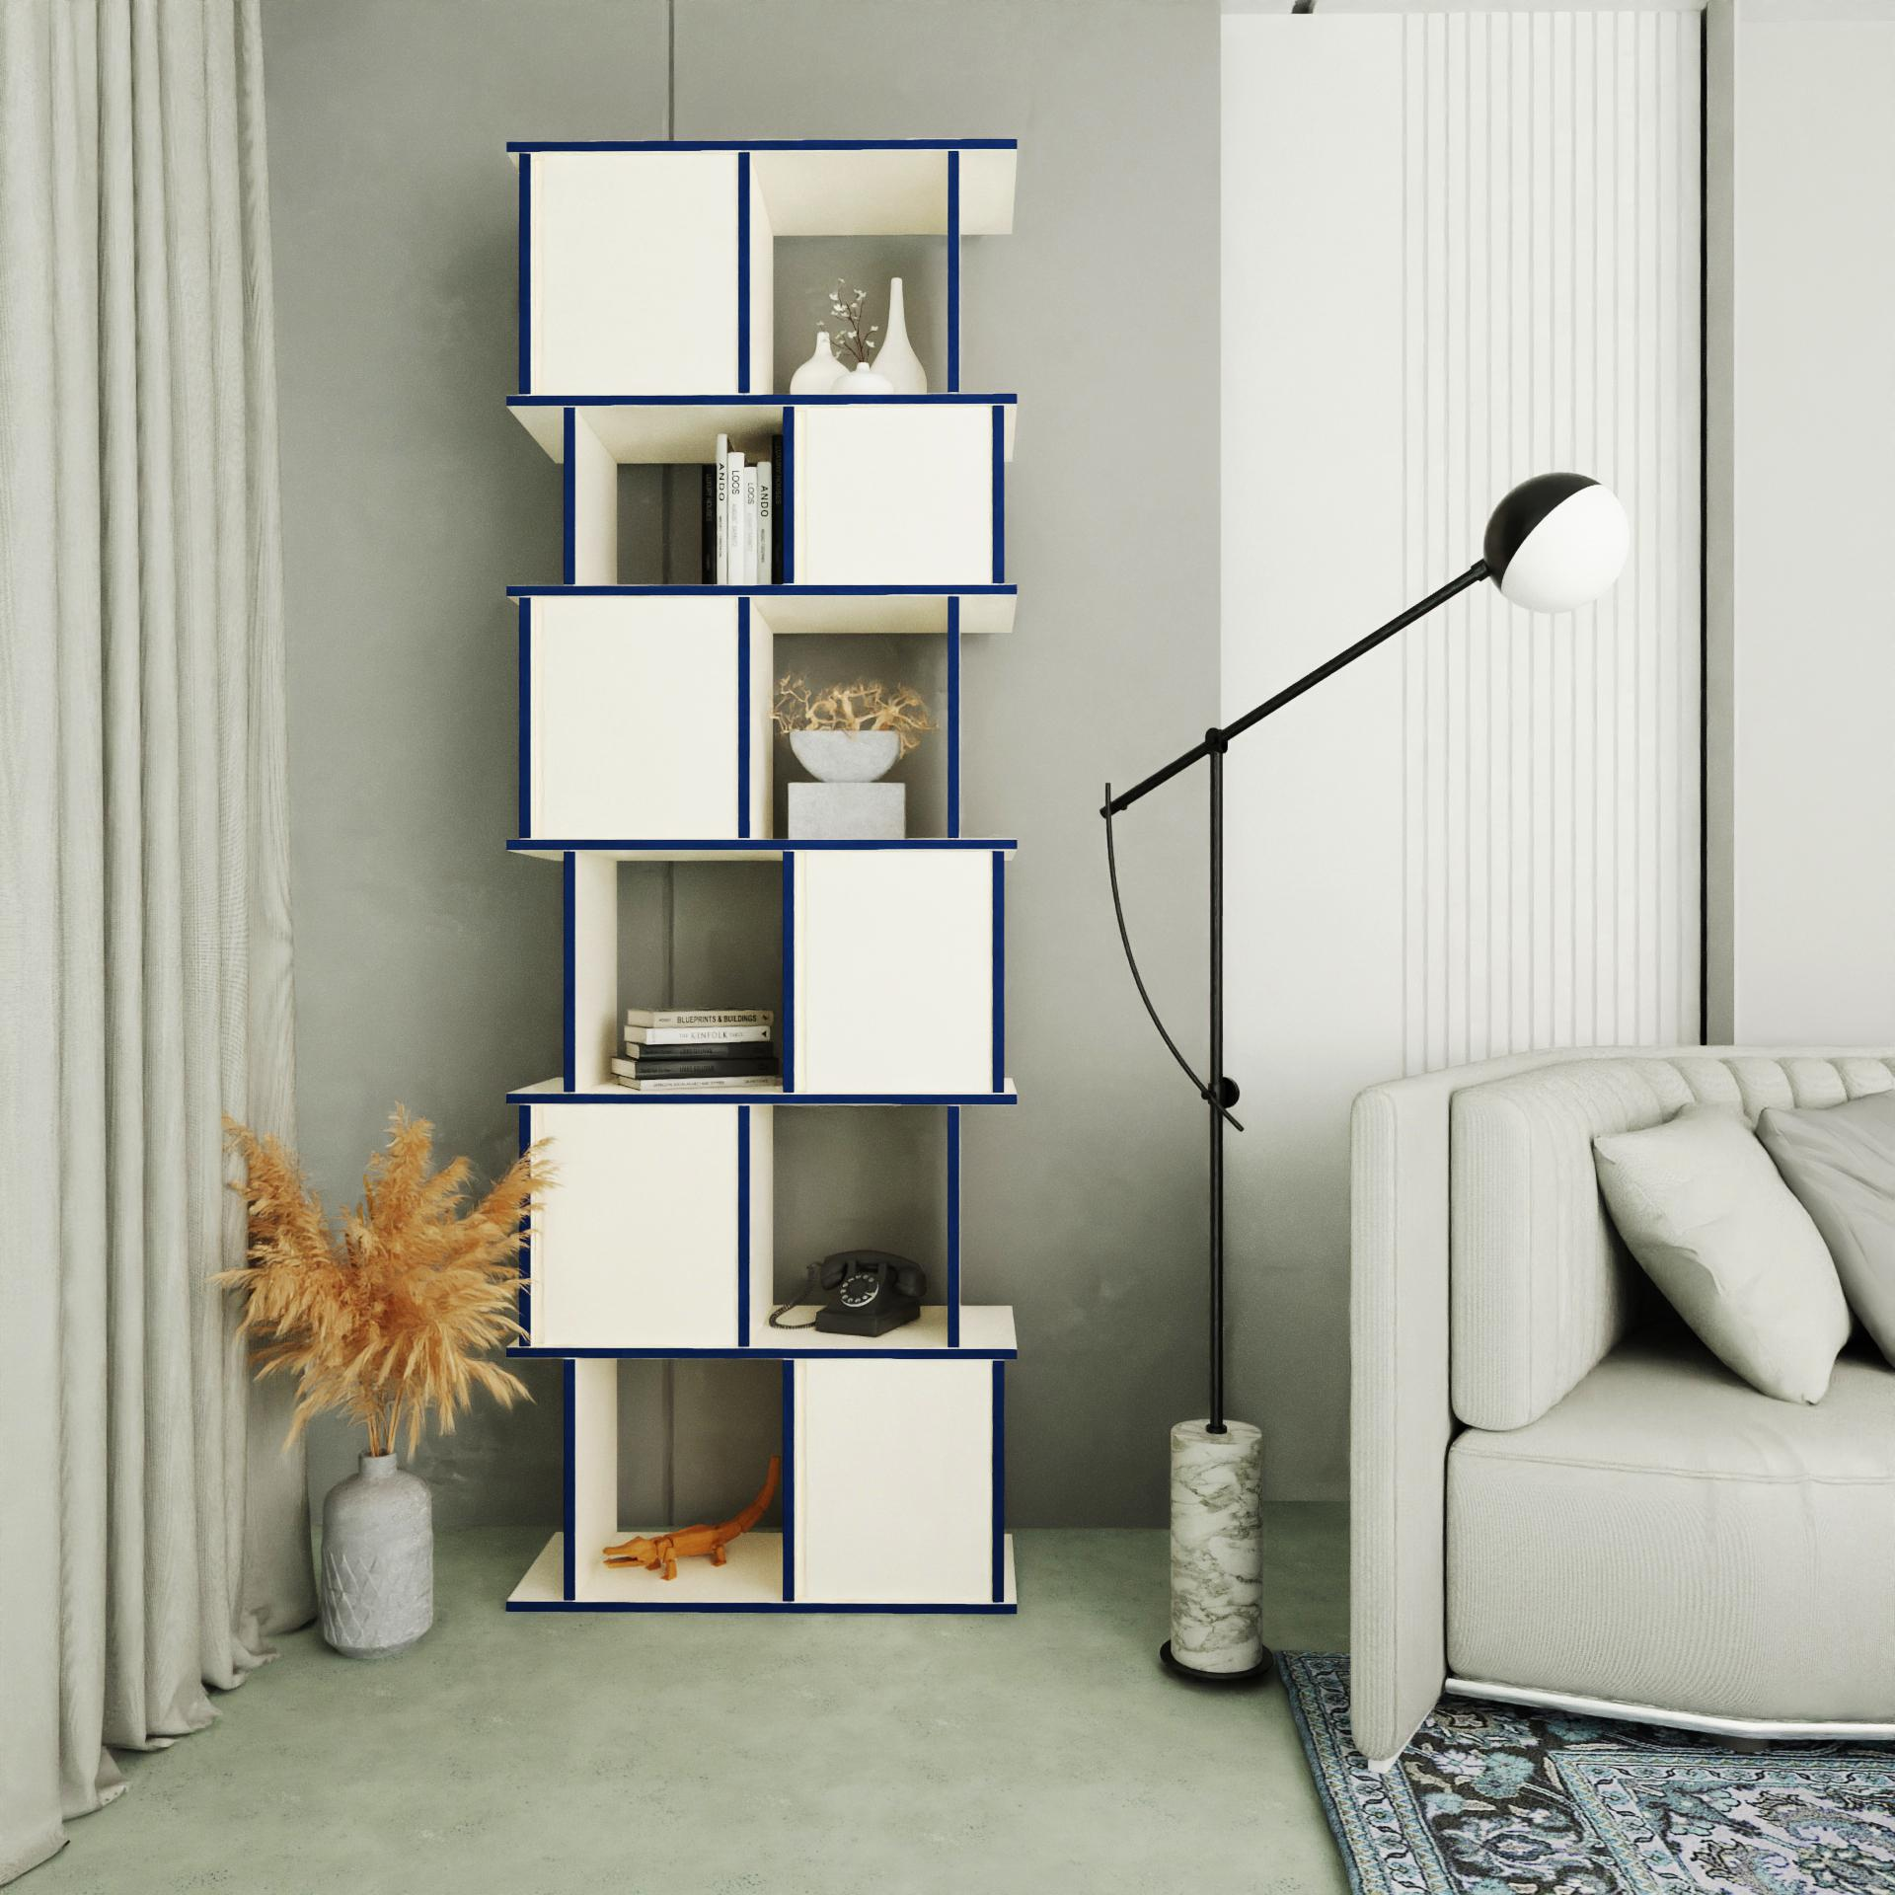
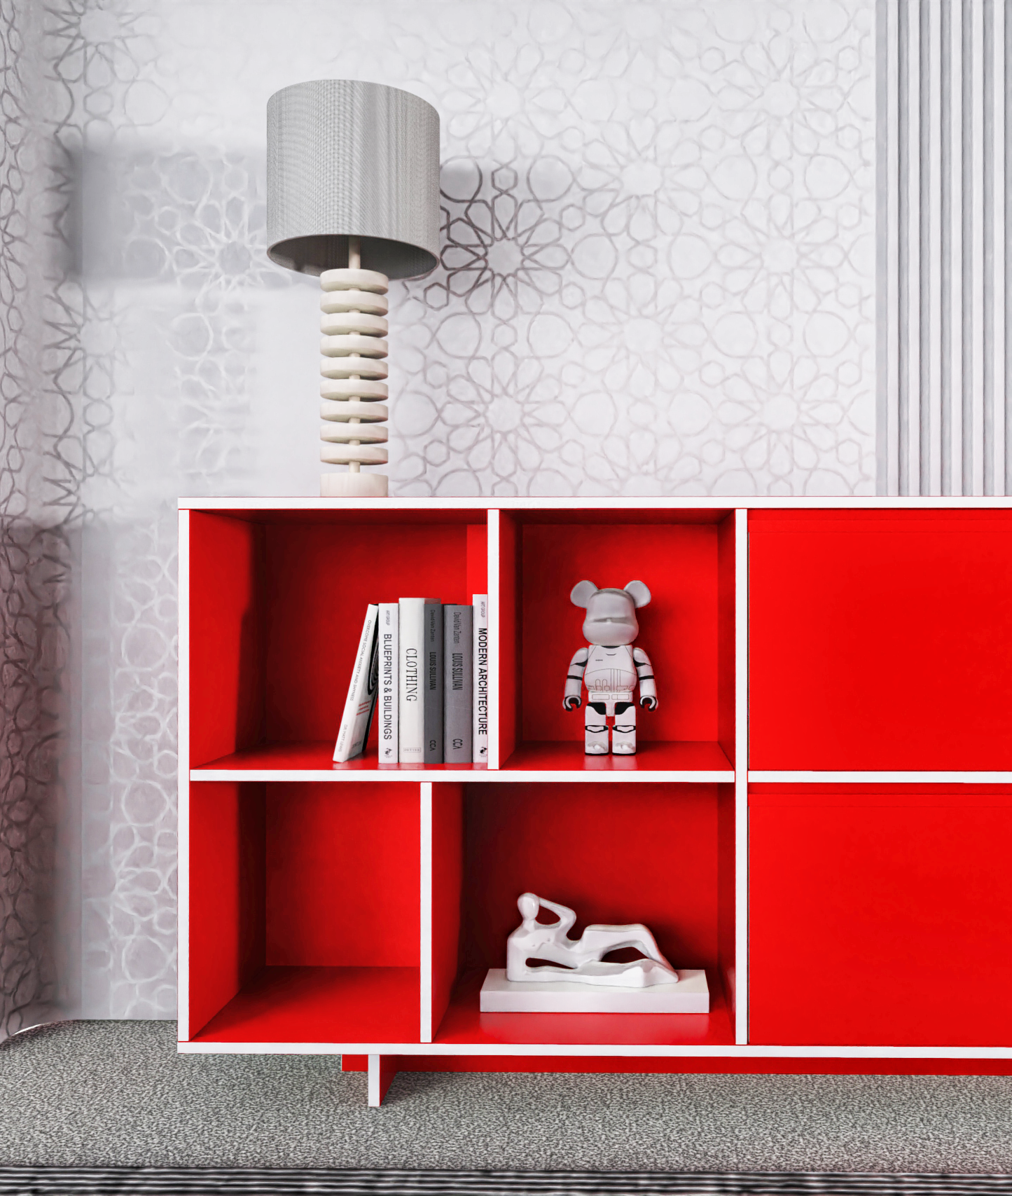
Modern Design
1. Designs that are guaranteed to fit every personality.
6.
Notes:
Designs that are guaranteed to fit every personality, space and manufacturer

Slide 12
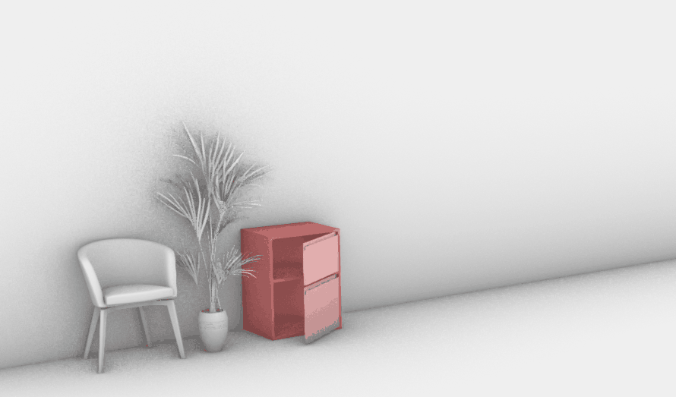
Truly Tailored
2. Easy-to-use 3D Configurator tool makes everyone a designer.
7.

Slide 13
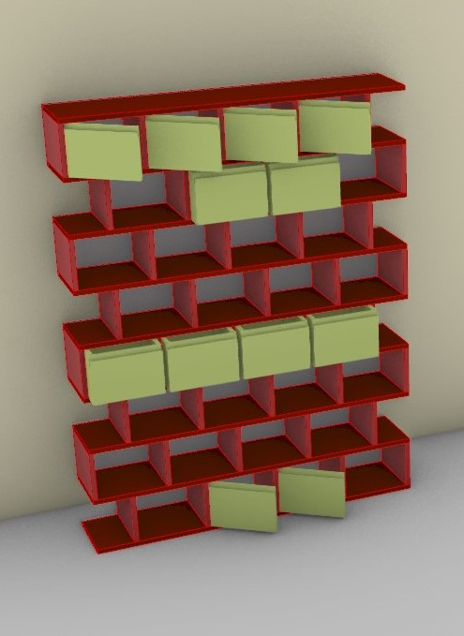
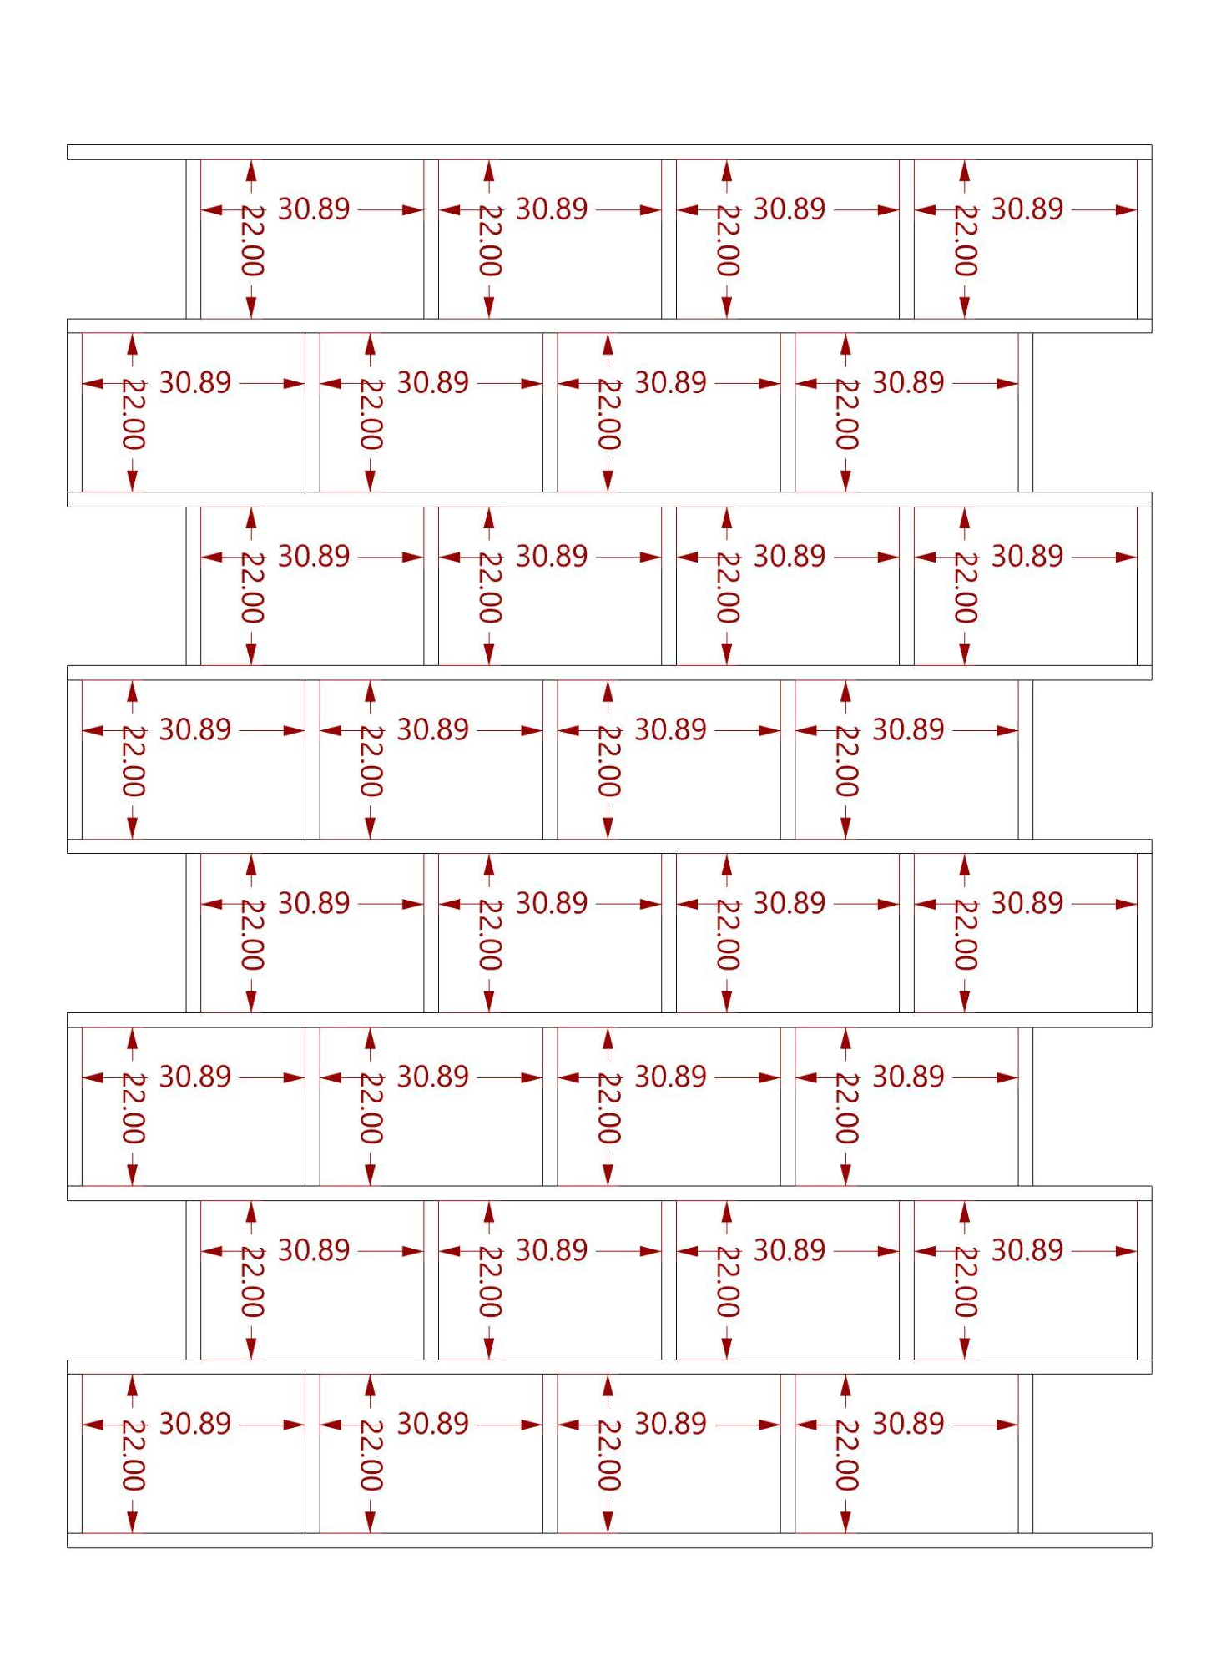
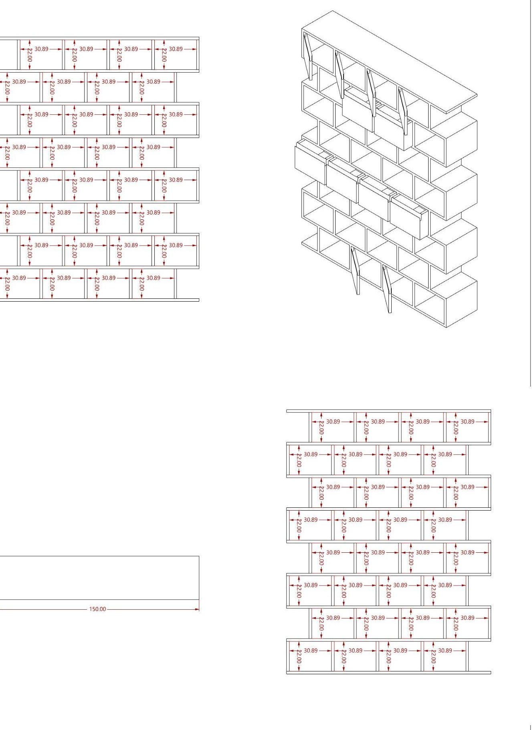
Automated
3. Custom orders converted to documentation.
8.

Slide 14
Where we are?
3D Configurator - MVP
3 Product Categories
Committed Manufacturer on Board
9.

Slide 15
Market
$27 Billion
$4.70 Billion
$870 M
MENA Market (2022)
North Africa Market (2022)
Tunisian Market (2022)
10.

Slide 16
Business Model
40%
60%
Manufacturing
Direct-to -Consumer: (Established Brand)
Gross Margin
11.

Slide 17
Roadmap
Q4 2022
2023
2024
Launch 3D Config 5 Product Categories
Product improvement
Launch in KSA
AR integration
Advanced 3D Config. (CNC)
Tunisia + KSA+ UAE
12.

Slide 18
Ask
Product Dev.
Marketing
15%
$250,000 / 18 Months
40%
Grow the Birdhouce Brand
Develop our tech. for scale
Expand to our next market
20%
Team
25%
Operations
13.

Slide 19
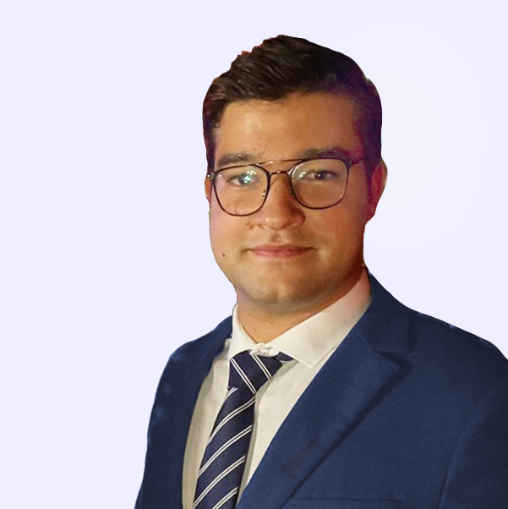
Team
Advisors
Malik Nouira
Ramzi Chahin
Khouloud Ben Aziza
Baha Ayari
Yanis Boulares
Moufeed Kadoura
Founder & CEO Prefabulous Architecture Industry
Founder & CEO Allure Home Furniture Industry
Founder & CEO 5 years experience Design and Manufacturing
Marketing and Social 3 years experience Marketing
Lead Designer 3 years experience Furniture + Product Design
Founder & CEO Kenota Health Y-Combinator
14.

Slide 20
Thank you !
Ramzi Chahin
ramzi.c@birdhouce.com www.birdhouce.com
15.

